Slide 1
26.3.20 Measure in cms
https://www.bbc.co.uk/bitesize/clips/zvsvcdm
Top tips for measuring!
Make sure the ruler is facing the correct way up.
Measure on the centimetre side not the millimetre or inches side.
Remember to line up the object to the 0 mark on the ruler.
Notes:
Children measure to the nearest centimetre using a ruler or tape measure.
They measure both length and height and focus on the importance of measuring from 0 rather than the end of the ruler or tape measure.

Slide 2
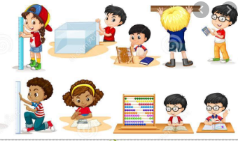
26.3.20 Measure in cms
Choose a variety of objects and practice measuring them using a centimetre ruler.
Record your results like this
Pencil- 15 cm
Reading book- 12 cm
Water bottle- 25 cm
Notes:
Encourage children to only measure things that are the same or less than the length of their rulers/tape measures.
Mathematical talk
What is the length?
How can the numbers on the ruler help us?
How do you know you have drawn a line that is 5cm long?How can you check?
Why is it important to start measuring from 0 on the ruler?

Slide 3
26.3.20 Measure in cms
Can you sort your results into this table?
Less than 30 centimetres | More than 30 centimetres
Notes:
Mathematical talk
What is the length?
How can the numbers on the ruler help us?
How do you know you have drawn a line that is 5cm long?How can you check?
Why is it important to start measuring from 0 on the ruler?

Slide 4
26.3.20 Measure in cms
Fancy some extra challenges?
Draw a line that is:
•5 cm long
•8 cm long
•Longer than 4 cm but shorter than 7 cm.
Measure your lines to check you are correct. Don’t forget to start from zero!
Notes:
Challenge 2 Answer
Mo is incorrect because he has not lined the car up with the 0 marker. If he had measured from 0 he would see that the car is 7 cm long..

