Slide 1
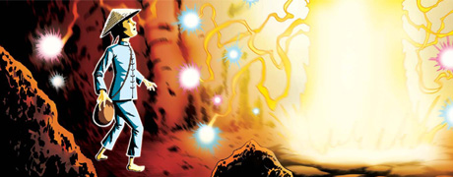
Year 4 English
Tuesday, 31st March, 2020

Slide 2
Tuesday, 31st March, 2020 To write a story build up and problem
Today we will continue to write our own planned story based on ‘The Firework Maker’s Daughter.’
This is the second of three days that we will spend writing our version.
Make sure you continue to follow Friday’s plan. The next slides shows which section you’ll be writing today.

Slide 3
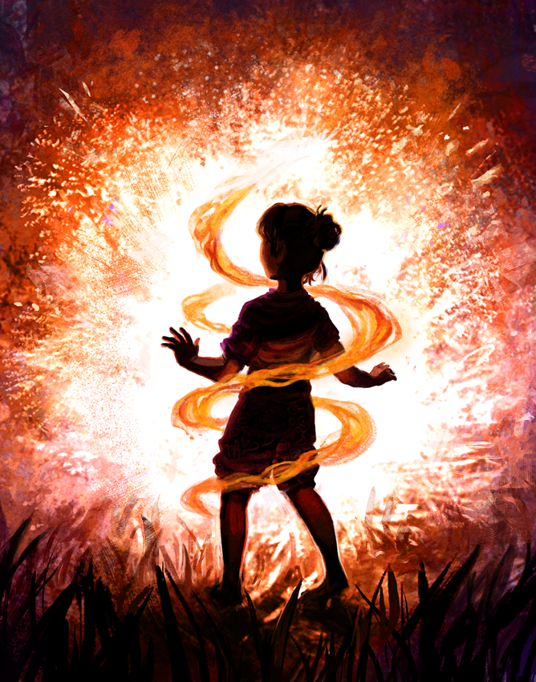
Day by day sections of our story
Section | Events | Day
Beginning | Main character and parent disagree about future | Monday
Build up | Main character leaves on journey | Monday
Build Up 2 | Parent and friend discover and react to the news | Tuesday
Problem | Main character is in danger on their journey | Tuesday
Climax | Main Character faces the enemy | Wednesday
Resolution | Parent and friend save character. Character is able to fulfil dream. | Wednesday

Slide 4
Task: Write the build up of your story. This should be the third and fourth sections of your plan and should be about a page long.
In today’s section your main character’s parent and friend should be discover that they have left home to try to achieve their goal. This section should include the parent’s worry and decision to chase after them along with their friend.
The main character shown also face a problem or danger, just as Lila did as she struggled through the mountains.
Read the third and fourth sections of your plan carefully before starting.

Slide 5
Task: Write the build up of your story. This should be the third and fourth sections of your plan and should be about a page long.
Try to include the following in your work:
Use personification, similes and metaphors to develop your descriptions.
Share the changing feelings and emotions of your characters.
Use last week’s new sentence structures in your writing.
Describe the setting that your main character travels through.

