Slide 1
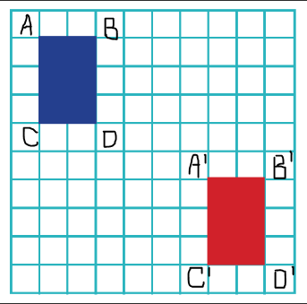
L.O: To understand how to translate a shape 24.03.2020 / XXIV. III. MMXX
"Translation" simply means moving ... without rotating, resizing or anything else, just moving.
To Translate a shape: Every point of the shape must move the same distance and in the same direction.
The blue rectangle was translated on the grid. Count how many spaces the rectangle moved. Start at A and move to A’. If you need to check your work, count again from B to B’.
The shape translated 6 Right, 5 down

Slide 2
Tick the translation from shape A to shape B.
Remember: if you start at the top corner of shape A you must translate to the top corner of shape B
A
 | 5 right, 3 down
 | 5 right, 2 down
B
© Classroom Secrets Limited 2018

Slide 3
Starting from shape A each time, circle the translation that has not been completed.
Complete the missing translation.
 |  | A
3 right, 2 down
0 right, 5 down
5 right, 5 down

Slide 4
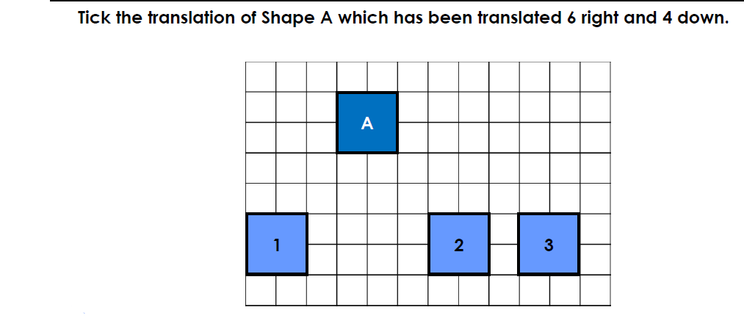
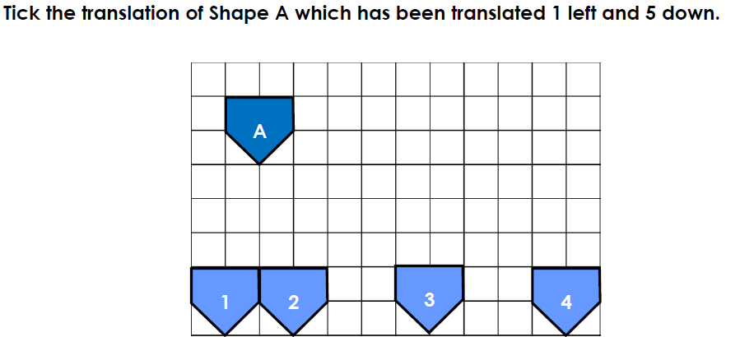
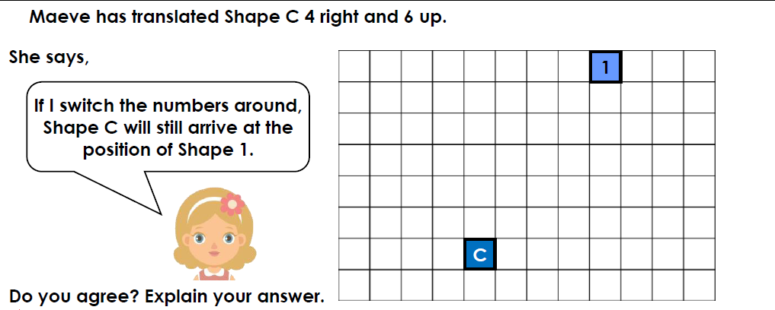
Answer the following questions:
Answers (from top to bottom):
Shape 3
Shape 1
If Shape C translates 6 right and 4 up instead, it will not arrive at the same position as square 1, so Maeve is incorrect.

Slide 5
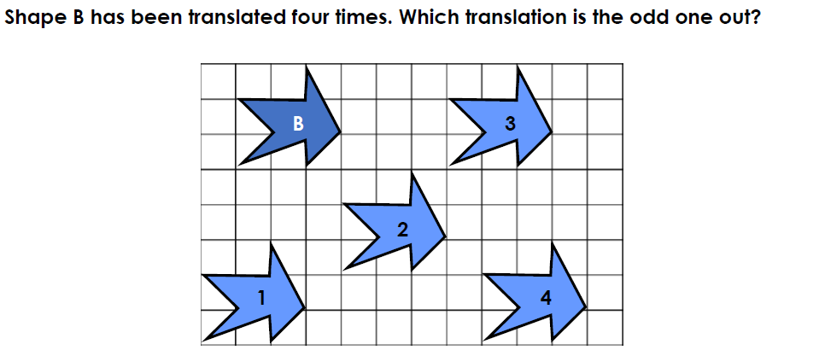
Daily Maths Challenge:
There are many possible answers to this question. How many can you find?
Possible answer: Shape 4 is the odd one out because when its
total movement is added together, it does not equal 6.

