Slide 1
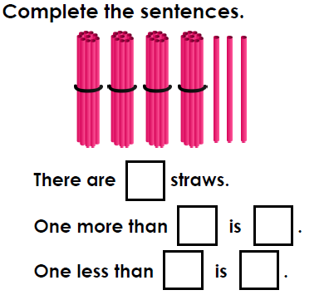
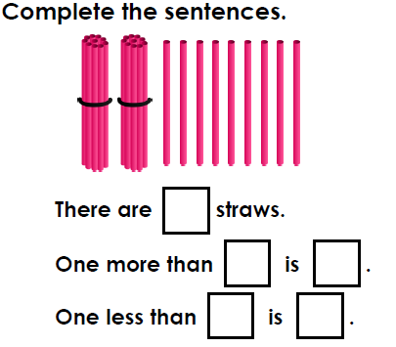
Wednesday 1st April Warm-up activity let’s revisit counting in 10s and ones to find the answers to the problems below.

Slide 2
Today we are comparing the capacity and volume in containers using the language ‘more, less and equal’.
Activity 1
Take three different containers.
Fill each container with water using the same unit of measure e.g. cup.
Make a label for each container saying how many units is needed to fill the container.
Which container holds the most? Which container holds the least?
Order the containers from largest to smallest capacity.
Notes:
This activity is similar to yesterdays but requires the child to order containers by capacity.

Slide 3
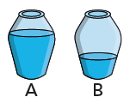
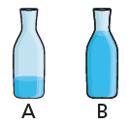
Now we are going to compare the volume in containers. Capacity tells us how much a container can hold when it is filled to the top. Volume tells us how much is actually in the container.
Use the words ‘more’ or ‘less’ to compare the volume of liquid in the containers.
A has _____ than B. A has _____ than B.
A has ______than B. A has _____ than B.
Notes:
Capacity refers to the total amount capacity is the total amount of fluid that can be contained in a container and the word we use when we are measuring liquids. Volume is how much space is taken up by the fluid in the container which may not be completely full.

Slide 4
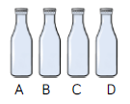
Comparing the volume in containers
Activity 2
Using 3 identical containers eg: empty water bottle, cup, jug, label them A, B and C.
Now fill them following this instruction:
Can we show A has more than B but less than C?
Now use 4 containers, labelled A, B, C and D.
Fill them following these instructions:
A has more volume than B but less than C.
C has equal volume to D.
If you do not have 3 or 4
identical containers you
could show this by drawing and
colouring the volume in the
containers.

Slide 5
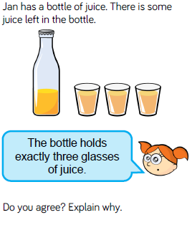
Todays problem:
Notes:
I disagree. Jan has filled three glasses exactly but there is still juice left so she could have filled more than 3.

