Slide 1
Wednesday 1st April
Well done for writing your shape poems yesterday, now we are going to learn how to write an acrostic poem about Easter.

Slide 2
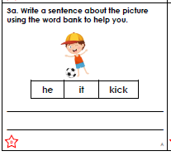
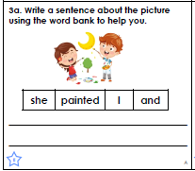
Warm Up
Can you complete a starter activity in your green books. You can choose the challenge or could do both.

Slide 3
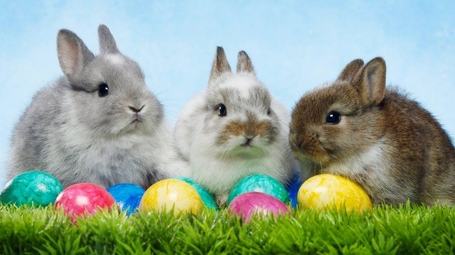
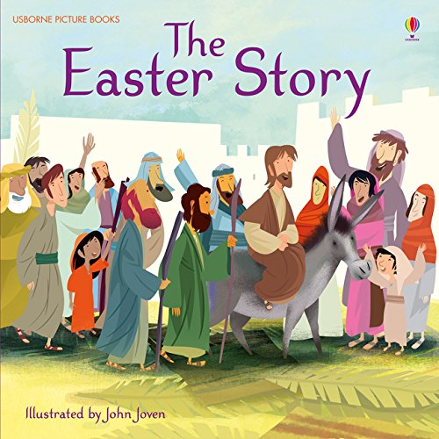
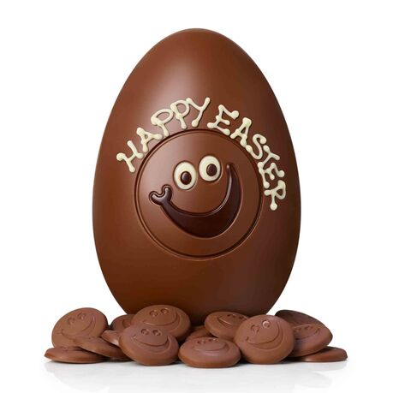
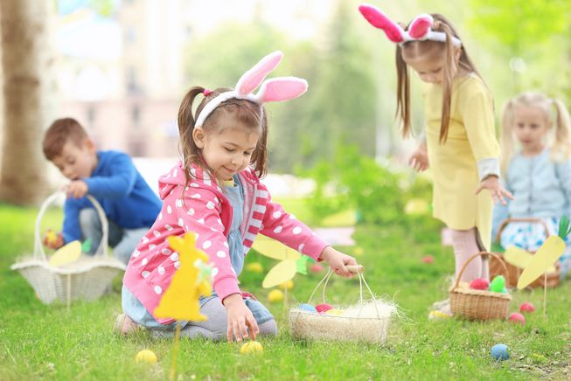
Easter
Write a list of everything you can remember about Easter?
Can you write down your favourite things about Easter?
Notes:
The children will use this list to give them ideas on what to include in their acrostic poem tomorrow.

Slide 4
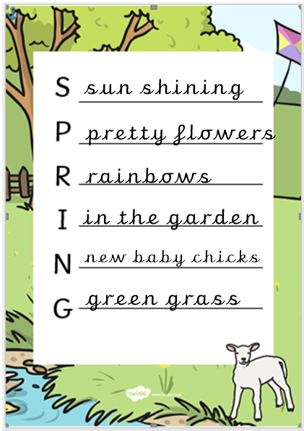
Spring Poem
Look at this poem, what do you notice about it?
Notes:
Read the poem together and encourage the children to notice that each line starts with the letters that spell out Spring.

Slide 5
Challenge
To prepare for writing tomorrows poem, look at your list of Easter things. Do any of them start with one of the letters in the word Easter?
E
A
S
T E
R

