Slide 1
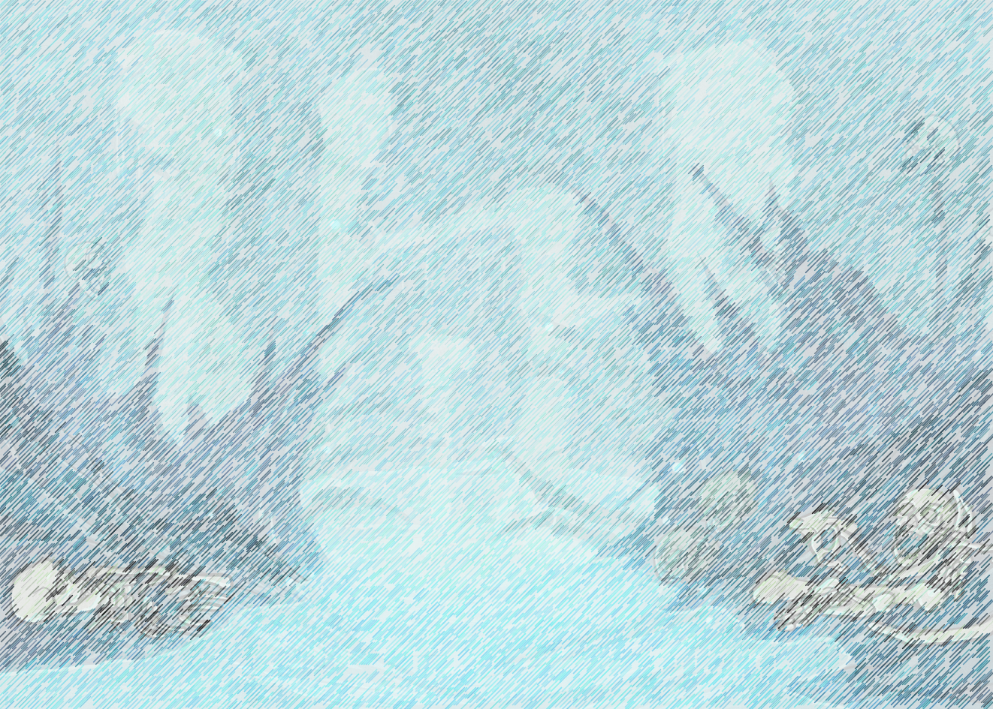
“I will find the monster’s lair and will bring the children home,” promised Tomas.
Dialogue
What a character says. Use speech marks and a reporting clause.
Fronted adverbial
A part of the sentence, which can end the sentence or can be brought to the start. If brought to the start, use a comma.
Friday third April 2020
LO:-To write the beginning of your own Greek Myth
Steps to success:-
I can use dialogue.
I can use fronted adverbials.
I can use similes
I can choose appropriate vocabulary
I can write in the past tense.
Similes
His horns were as sharp as knives.
As the cyclops left, he stomped and snarled.
Past tense
The parents cried out every night.

Slide 2
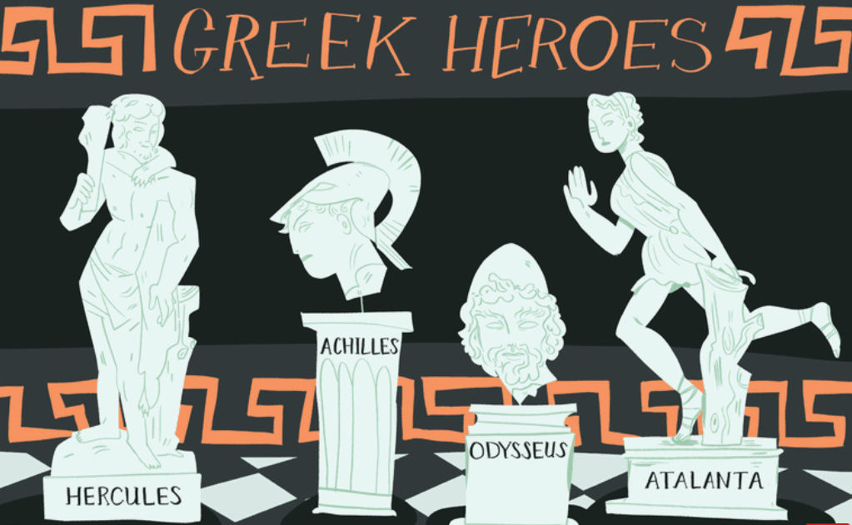
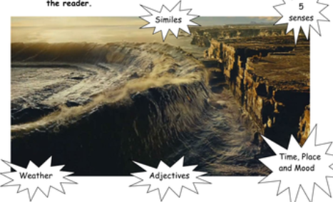
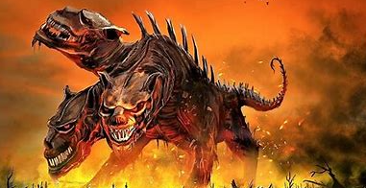
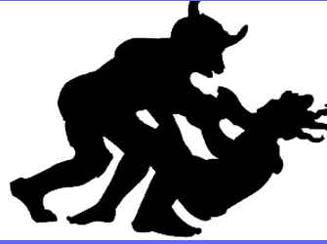
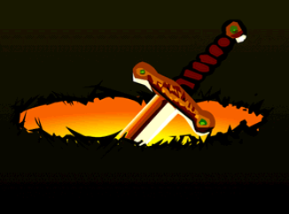
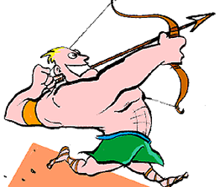
Hero or Heroine
Setting
Hero
Introduce the hero
Monster
Setting
Describe, where the story takes place. Use your senses.
Problem
Explain what has caused the problem. Introduce the monster.
Sandy Bay
Shark infested
Creatures pulling you under water
Sucking sand
Scary crabs that grab
Slippery on the slimy rocks
Rocks covered with seaweed
Evil Devilish Three Headed
Poisonous Fangs Crushing Jaws
Crushed Ate Poisoned swallowed
Towering muscular venomous fangs
Hercules Strong
Powerful Courage Strength
Intelligent Killed Defeated Overpowered a lion
Amazingly Strong as an ox.
Problem
Weapons/Tools
Ending/Resolution
https://www.bbc.co.uk/teach/school-radio/ks2-ancient-greece/zk73nrd
Killed villagers.
Destroyed habitats
Each night
Every evening
Finally defeated Evil cyclops Ravenous minotaur conquered
Returned home
Villagers freed
With safety for the villagers guaranteed
Shield enormous spear golden axe invisibility cloak vanquished conquered overpowered
In a flash Using all her strength
Pointing the arrow upwards
With the gift from Athena…

Slide 3
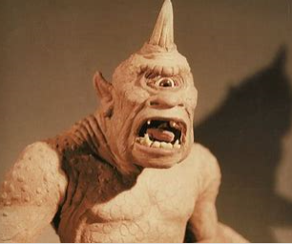
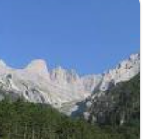
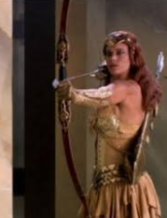
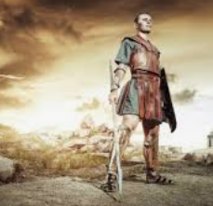
Long ago, in the town of Aretha, in the mountains of ancient Greece, where long horned mountain goats and soaring eagles with huge wings flew, a cyclops destroyed the peace and tranquillity every month. Villagers of Aretha dreaded the day each month, when animals and children disappeared. A huge, bloodthirsty, hideous monster entered the village and stole children from their homes.
The mountainous village of Aretha
Cyclops
The villagers tried to rescue the children, but were flung into the air by the monstrous arms of the cyclops. His humongous feet stamped and stomped through the woodland, as he dragged his victims to his lair. After the kidnapping, the village was left in silence and the villagers feared the tiny children were lost forever. The villagers felt as weak as cotton and as feeble as petals, when faced with the strength of the gigantic beast. The parents wailed and moaned every night and felt broken hearted, as their children once stolen, never returned.
Tomas
Greek God
Artemis

Slide 4
One of the village children did survive kidnapping and once fully grown and an adult, he promised his mother and father, he would destroy the evil creature. “I will seek this demon and bring the children of Aretha home,” assured Tomas. He would follow the one eyed beast to his lair.
The mountainous village of Aretha
Cyclops
The hero Tomas was brave and very wise and he realised, that he needed extra help, as he was a mere mortal. Every night, he prayed to the god Artemis, who was renowned for her strength and courage. He felt hopeful, that Artemis would assist him in the quest before him….
Tomas
The Greek god Artemis.

Slide 5
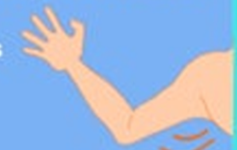
Mild
Write a sentence for your:-
Setting
Monster
Hero or heroine
Monster and problem
Look at your box plan and word banks to help you.
Setting
Problem
Monster
Take some time to edit your work. Ask a grown up or an older sibling to help.
Hot and Spicy
Write at least two sentences about your:
Setting
Monster
Hero or Heroine
Monster and problem.
Add similes, fronted adverbials, dialogue and wow vocabulary.
Extra challenge finish your story during the Easter holidays. Which weapons is your hero/heroine given. How is the monster defeated? Use your word banks, plan and work over the last week to help you.
Hero/Heroine
god

