Slide 1
Year 3 Fractions
We are learning to:
Count up and down in tenths
Recognise that tenths arise from dividing an object into 10 equal parts and in dividing one-digit numbers or quantities by 10
© Inspire and Educate

Slide 2
What numbers are missing?
0
$$1$$
0.1
0.2
0.3
0.4
0.5
0.6
0.7
0.8
0.9
$$\frac{1}{10}$$
$$\frac{2}{10}$$
$$\frac{3}{10}$$
$$\frac{4}{10}$$
$$\frac{5}{10}$$
$$\frac{6}{10}$$
$$\frac{7}{10}$$
$$\frac{8}{10}$$
$$\frac{9}{10}$$
0
$$1$$
© Inspire and Educate

Slide 3
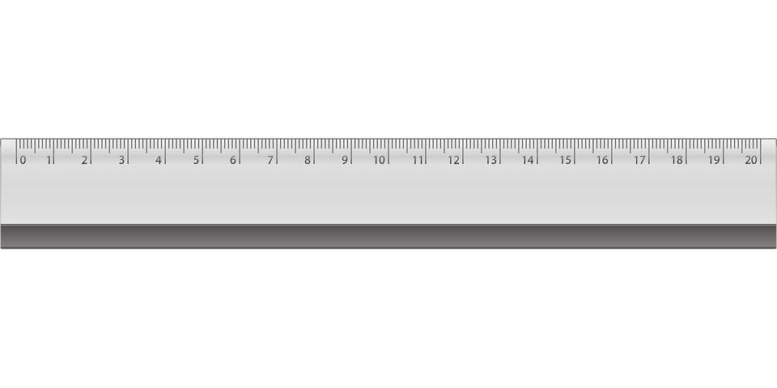
Counting in Tenths
In decimal fractions what number is the arrow pointing to on the ruler?
0
5
$$10$$
$$\frac{6}{10}$$
© Inspire and Educate

Slide 4
Fraction Decimals
In decimal fractions what number is the arrow pointing to on the ruler?
0
9
$$10$$
$$\frac{6}{10}$$
© Inspire and Educate

Slide 5
Fraction Decimals
In decimal fractions what mixed number is the arrow pointing to on the ruler?
17
5
$$10$$
$$\frac{6}{10}$$
© Inspire and Educate

Slide 6
Fraction Decimals
In decimal fractions what mixed number is the arrow pointing to on the ruler?
10
8
$$10$$
$$\frac{6}{10}$$
© Inspire and Educate

