Slide 1
Monday 20th April Year 4 Maths LO To solve problems with hours, minutes and seconds.
SUCCESS CRITERIA
I can solve problems with hours minutes and seconds.
I can convert minutes to hours and hours to minutes.
I know how many units in minutes and hours.
Dear Children,
I hope you are all keeping safe and sane. In these extraordinary times, you are being asked to be very responsible in taking control of your own learning. Please try to do all the tasks.
I see that only a few of you are doing Mathletics. It can be very helpful for your Maths and the tables games are a fun way to learn. Please let the office know if you are unable to access the website. I will find another way to set work for you.
Stay well!
Mrs. Voges
ACTIVITIES
Work through the worksheets – Mild, Hot and Spicy – as far as you can go!
Challenge
Mathletics
Practise your 6X table

Slide 2
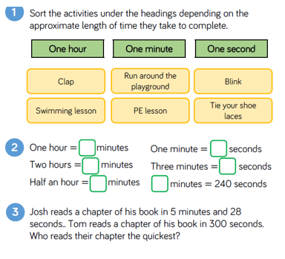
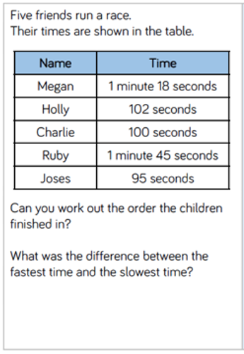
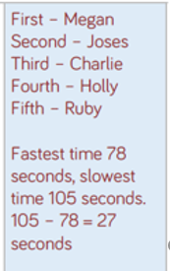
Answer the questions below:
Click to reveal the answers

Slide 3
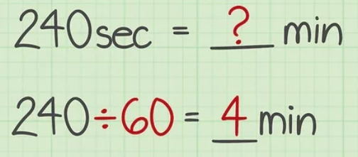
When converting remember:
1 minute = 60 seconds
Convert 80 seconds to minutes:
1 minute (60 seconds)
80 – 60 = 20 seconds
So 80 seconds will be
1 minute and 20 seconds
60 minutes = 1 hour
Convert 3 hours to minutes
1 hour is 60 minutes
So 3 hours is 60 X 3
= 180 minutes

Slide 4
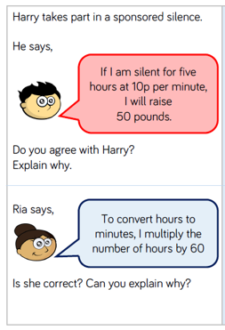
Read the problems carefully to work out the answers.
Click to reveal answers
When you solve a problem, break it down into small parts.
Ask the question –
How many in 1 minute or what is the cost of 1 minute?
Draw the picture
10 p for 1 minute
10 p for another minute
And another until you have
60 to make up the hour
This is multiplication so
10p X 60 = 600p or £6.00

Slide 5
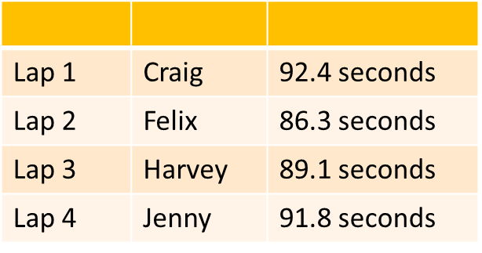
When converting:
CHALLENGE
4 children are on a relay race. These are their times.
Round each time to the closest second.
Convert the times to minutes and seconds.
Who ran the fastest time?
How long did the whole race take?
Hours to minutes multiply by 60
Minutes to hours divide by 60
Minutes to seconds multiply by 60
Seconds to minutes divide by 60

