Slide 1
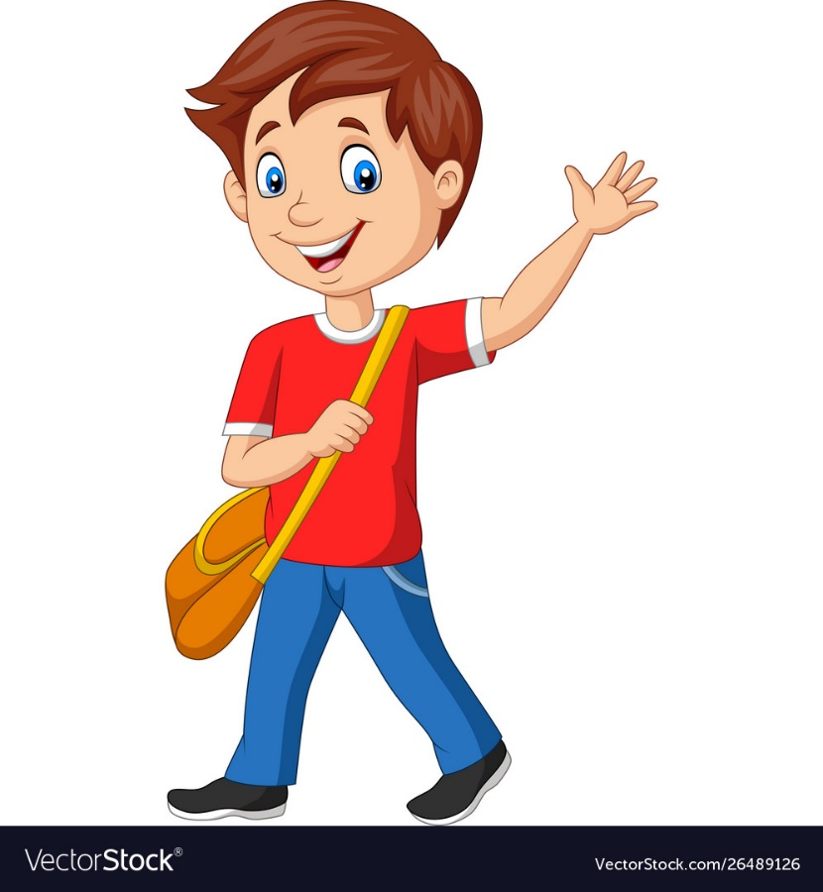
LO: To use capital letters correctly
Monday 20th April, 2020

Slide 2
Proper Nouns
Nouns are naming words.
Proper nouns are naming words for individual people, places, days of the week and months of the year.
Proper nouns all need capital letters.
Common Nouns | Proper Nouns
girl | Helen
country | England
city | Sheffield
football team | Nottingham Forest
day/month | Monday/September

Slide 3
Activity
Can you spot the proper nouns in these sentences and add
capital letters to the beginning of them?
Have a go on your whiteboard.
ben and susan went to australia for their holidays.
Ben and Susan went to Australia for their holidays.
owen supports hull city fc.
Owen supports Hull City FC.

Slide 4
Now it’s your turn … TASK 1
Add capital letters in the right places in these sentences.
Remember, the beginnings of sentences, proper nouns and ‘I’ need capital letters!
it is always snowing in iceland.
i like going to london.
mariam and sophia went to the shops in sheffield.
when i was a baby i didn’t have any teeth.
my brother zach and i watch football every saturday night.

Slide 5
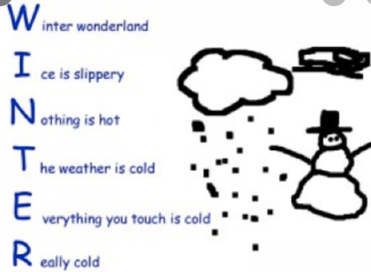
Task 2 –Easter Holiday
R
A
I
N
B
O
W
FOR EXAMPLE
It has been a very different Easter break for most of us, as we have not been able to spend much time outside of the house. We have also not been able to spend time seeing friends and family outside of our home.
People have thought of many things to raise spirits in this extraordinary time.
One strategy was to place pictures of rainbows in the windows of our houses. Rainbows can be symbols of hope – the sunshine after the storm.
Use the word – RAINBOW to be the basis of an acrostic poem. Each line of the poem will begin with a capital letter.
The lines of your poem will express your thoughts or feelings over this challenging period.

