Slide 1
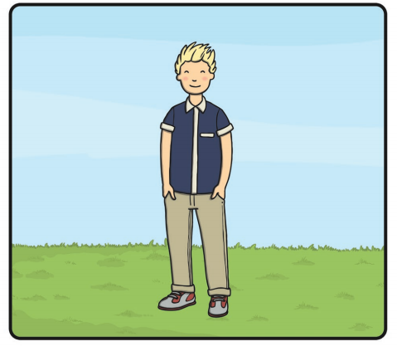
Friday 24th April Around the World in 80 days! – Paris, France.
Before we continue visiting Paris, unscramble this sentence and write it correctly, using a capital letter, finger spaces and a full stop.

Slide 2
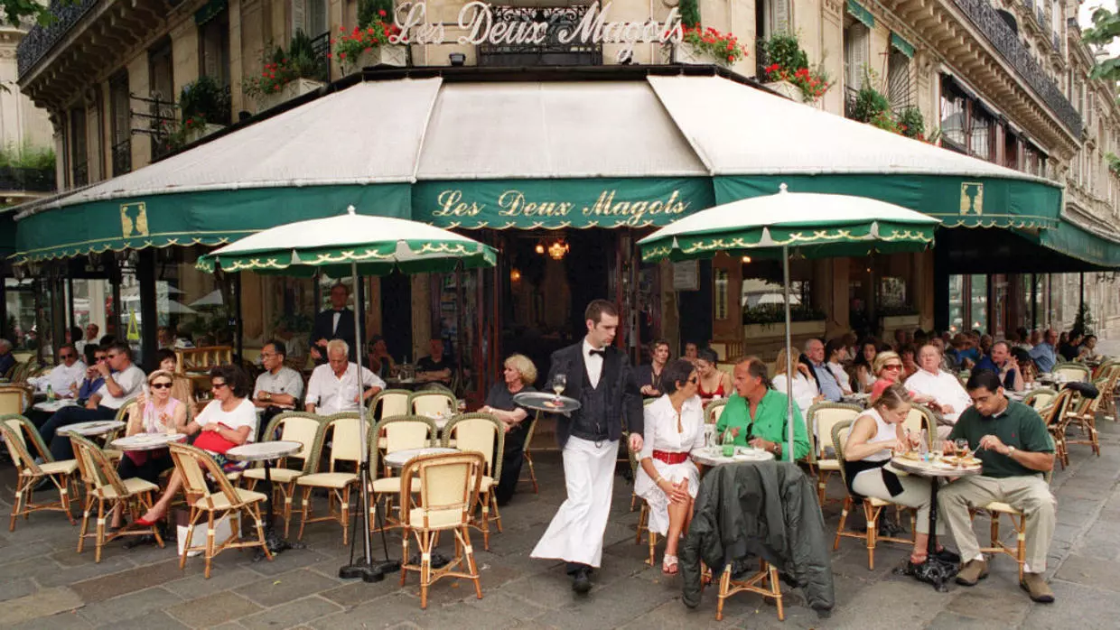
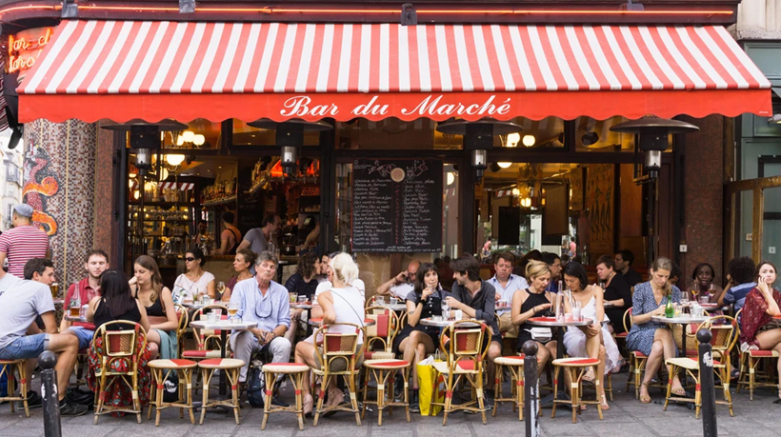
What else do we see when we walk around Paris?
In Paris, there are lots of cafés where you can get something to eat and drink. People can sit at tables and chairs outside and order their food.

Slide 3
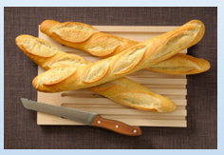
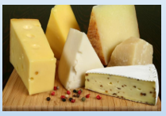
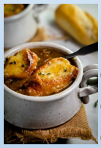
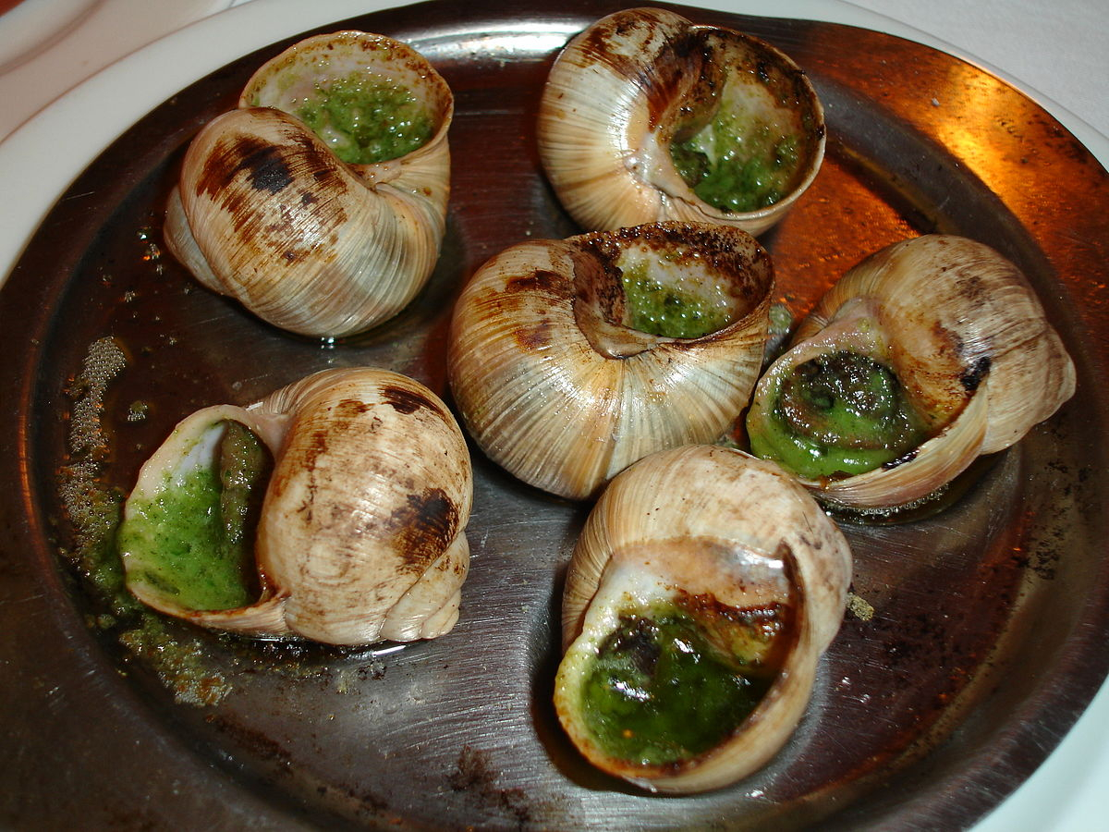
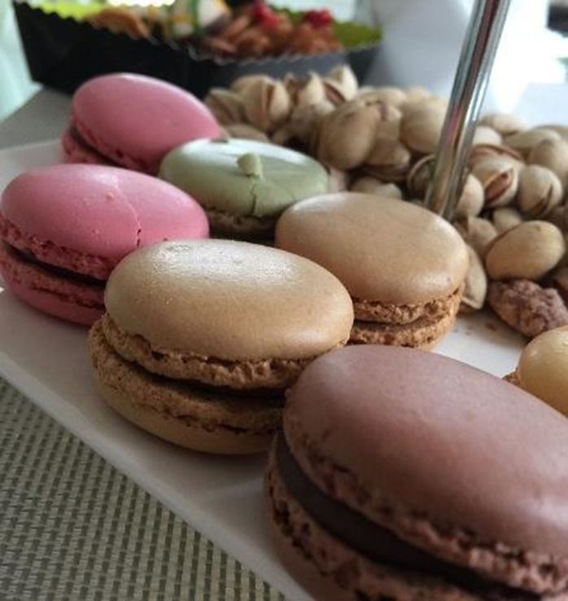
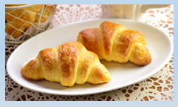
What sort of food do they eat in France?
Baguette
Crepes
Cheese
Onion Soup
Snails
Croissant
Macarons

Slide 4
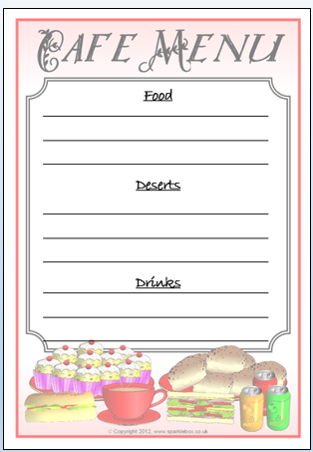
Today you are going to create a menu for a café in Paris.
What is a menu?
A menu is a list of food and drink that you can order at a café or restaurant.
Using the template shown, write your own menu.
Include some of the French food shown on the previous slide, you can also add your favourite foods to the menu!
Be sure to sound out the words and use your phonics.

Slide 5
Spellings Please practise reading and writing the words below.
here
there
where
come
some

