Slide 1
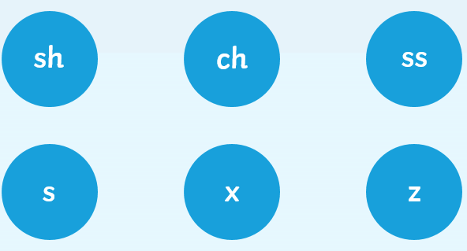
Wednesday 29th April Around the World in 80 days!
Yesterday we changed singular nouns into plurals by simply adding ‘s’.
But if the noun ends with one of these sounds, we need to add ‘es’.
Change these singular nouns into plurals by adding ‘es’.
brush brushes
torch
box
bus
witch
Princess
Fox
dish

Slide 2
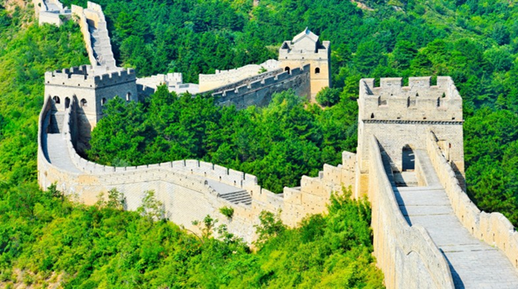
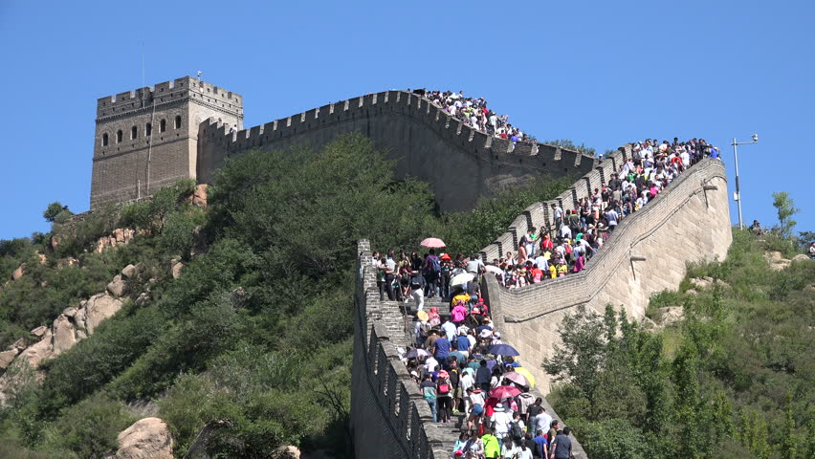
Let’s explore the Great Wall of China!
The Great Wall of China was built over 2000 years ago.
It was built to stop the enemy invading China.
It is over 13, 000 miles long.
It was not all built at the same time,
smaller walls were built separately and
then all the parts were joined together to make one long wall.
Over 10 million people visit the Great Wall of China each year!

Slide 3
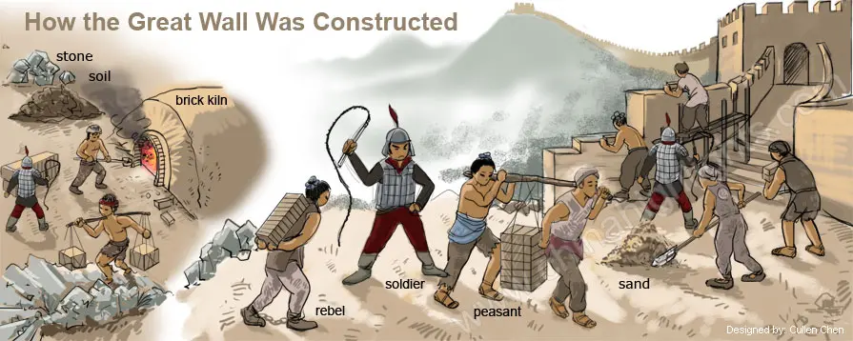
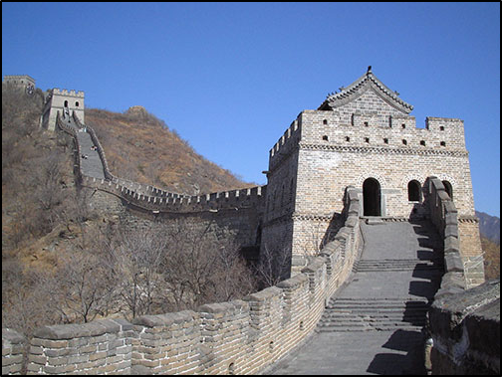
They used bricks, stones and soil to build the wall.
The soldiers took poor people, men from the farms and villages and prisoners to build the wall.
It was very hard work and got very cold in the mountains. Millions of the workers died.
There are over 7000 look out towers.
The watch towers were where the soldiers kept look out.
If they saw the enemy coming they lit a fire at the top of the tower to warn the others.
As the Great Wall is high up in the mountains the enemy was often tired when they reached the wall and the soldiers would fire arrows or roll huge boulders down on them.
Why don’t you build the Great Wall of China with Lego – don’t forget to send a picture in!

Slide 4
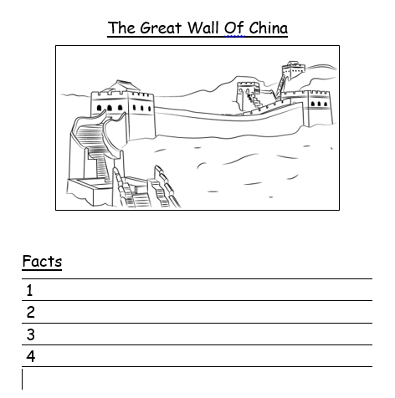
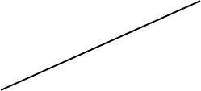
Today we are going to write a fact file on the Great Wall of China.
A fact file is a sheet that contains information about a person, place or thing. Remember when we wrote a fact file about Queen Victoria?
Today our fact file will look like this.
Draw a picture of the Great Wall of China.
Label the Watch towers.
Give your fact file a heading.
Write 4 facts about the Great Wall of China.
Number your facts and write each one in a sentence remembering capital letters and full stops.

Slide 5
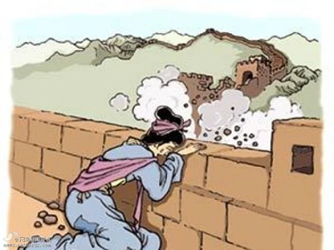
The Legend of Meng Jiangnu
Once there was a beautiful young girl called Meng Jiangnu who fell in love and married a man called Fen. They had only been married 3 days when the Emperor’s soldiers took Fen away to help build the Great Wall of China. Meng Jiangsu was very sad and waited five years for Fen to return, but he never did.
Then Meng Jiangsu had a dream that Fen was very cold and only had thin clothes to wear so she set off on a very long journey to take him some warm clothes.
When she reached the wall she could not find him and someone told her that he had worked so hard he had died. Meng Jiangnu was heartbroken and cried and cried, so much that part of the wall crumbled away.
Read the whole story here -
https://www.activityvillage.co.uk/meng-jiangnu-weeps-flipbook

