Slide 1
Time
LO: to be able to read and write the time.
Steps to success:
I can place the hands at the correct time.
I can read the time on the clocks.
I can use a number line to add the times together to say the final time.
I can solve problems related to time.

Slide 2
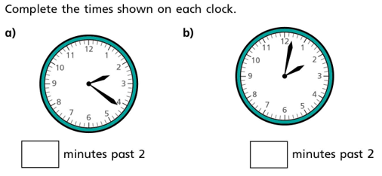
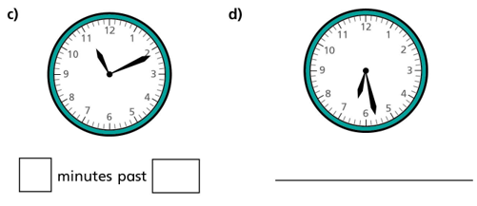
Use your clocks from previous lessons to help you work out the correct times.

Slide 3
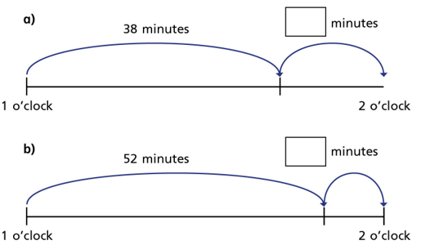
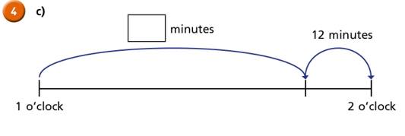
You will need to remember you time facts from previous lessons to find the missing minutes.

Slide 4
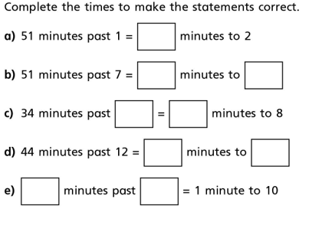
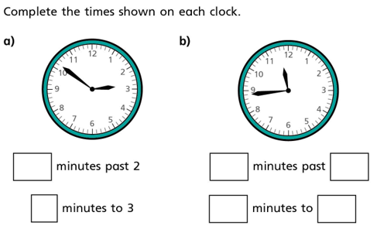

Slide 5
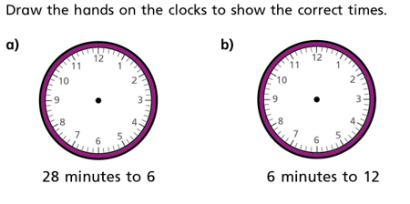
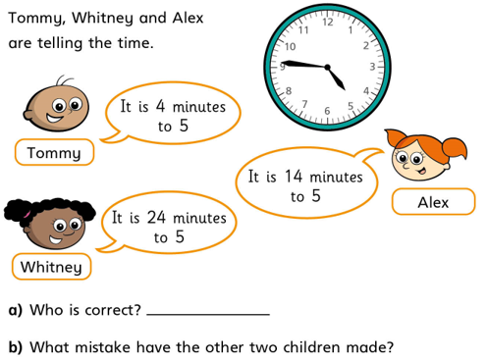
Please use a ruler to make sure your lines are straight and pointing to the correct number or space.
Discuss this first with an adult explaining your reasoning's.

