Slide 1
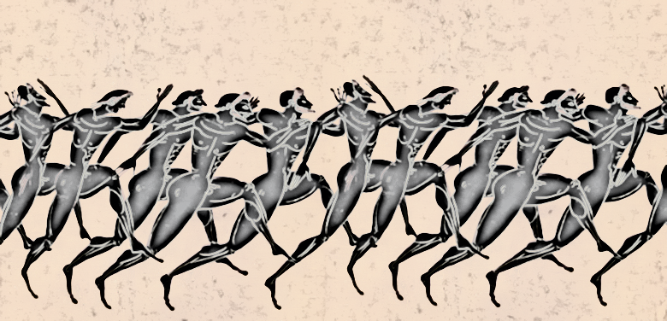
Wednesday 22nd April 2020
LO:- To write down information about the ancient Olympics.
To Steps to success:-
I can use comparatives and superlatives.
I can use similes.
I can write down sentences to remember facts.
I can write down key words to help remember facts.
I can discover facts about ancient Greek Olympic events.
I can discover the names of ancient Greek Olympic events.

Slide 2
Continue with the research and information gathering from yesterday.
Use the word banks below to help you write more wow sentences or add more wow words to your table. If you write words yesterday, move onto sentences. If you wrote sentences, up level your sentences, by adding wow vocabulary. If you are up for today’s spicy challenge, imagine you were an athlete, who competed in an ancient Greek Olympic event. Write a diary entry in the past tense.

Slide 3
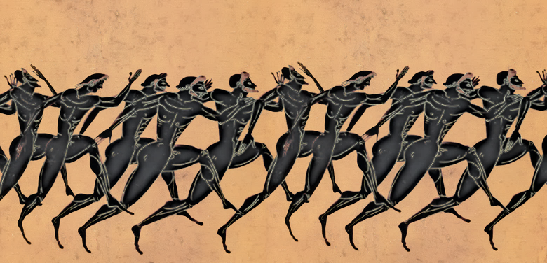
Adjectives
Nouns
Body physique muscles disc discus chariot hurl jump throw attempt heroism feat spectacle
Spectators elite perfection desperation anguish fear
Rejoicing desperation
Competition event
Muscular gigantic athletic strong enthusiastic dedicated monstrous
Enormous tremendous far-reaching
Incredible thunderous skimming deadly mighty lithe nimble herculean heroic lightning zooming flashing pounding awe inspiring wonderful ginormous transforming roaring bellowing supporting despairing exhausted
Competitive exhilarated
Past Tense Verbs
hurled attempted crashed leaped skimmed plunged
Vanquished defeated triumphed collapsed pushed
Rejoiced bellowed flung thrashed overtook collided destroyed competed bolted raced
Hurried pressed cling fought wrestled pierced
Tumbled locked in combat heaved participated performed competed raced

Slide 4
Hot
Continue filling in the table from yesterday but up level your language use some of the new vocabulary on the word banks above. Look at the slide below for extra challenging ideas. Write at least two sentences per Olympic event.
If you can add similes, superlatives and comparatives.
Spicy
Continue filling in your table from yesterday and up level the language, using the word banks to help you on the next slide. Use similes, comparatives and superlatives. As an extra challenge imagine you have taken part in at least one of the ancient Greek Olympic events and in the past tense write a wow diary entry about your experiences. Use all your senses. Add descriptions of the place, the crowd and the event itself, how you were feeling before, during and after the event.
Mild
Continue filling in your table yesterday with key words and at least one sentence for each of the three ancient Olympic sports you are researching.

Slide 5
Simile
Competitors ran as fast at the wind.
Those taking part were as strong as elephants.
The runners were as swift as cheetahs.
The wrestlers were
as
brave as lions.
Comparatives
The stronger wrestler defeated the weaker wrestler.
The faster he ran the bigger the victory.
The longer the jump, the greater the reward.
Alexander triumphs
As Alexander entered the Olympic stadium, his ears were filled with the huge roar from the spectators and he swelled with pride and he felt very excited. He could smell the sweat, the fear and the agony and he longed to start the race. He nervously, yet excitedly pushed forward to the start. As the race began, he hurled himself forward. He urged his whole, muscular body to push ahead. The crowd disappeared from his vision and he used every last bit of energy, to power himself across the finish line. He tasted the gritty sand and realised he had fallen forward onto the ground. He was unsure, if he had triumphed and had become the fastest runner that day, quicker than all his competitors. The bellowing crowd filled his heart with joy, as he realised he had succeeded and the laurel crown was placed on his sweaty head. He had triumphed and was the greatest athlete of the day, faster than an arrow. He was as mighty as a lion.
Superlatives
The strongest and bravest athletes were often victorious.
The bolder the rider the more chance of victory.
The greatest athletes took part.

