Slide 1
English
Wednesday, 29th April, 2020
LO: To write in the third person and past tense

Slide 2
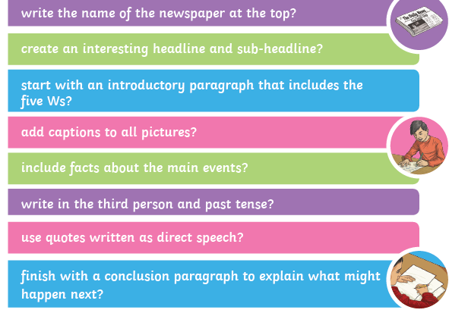
Past Tense and 3rd Person
News reports are written in the past tense when they are explaining events that have already happened.
The robber left the bank on his motorbike.
They are also written in the third person. We don’t usually use I (first person) or you (second person).
3rd person: He/she/it/they
What examples of past tense and 3rd person can you find in the following recount?

Slide 3
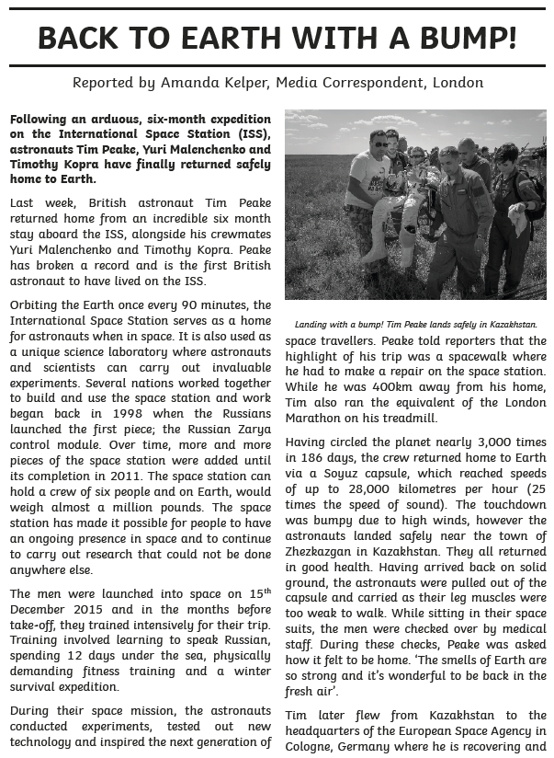
How many verbs in the past tense can you find?
Returned, broken …
Can you find some examples of third person use?
It has made
Peake was asked

Slide 4
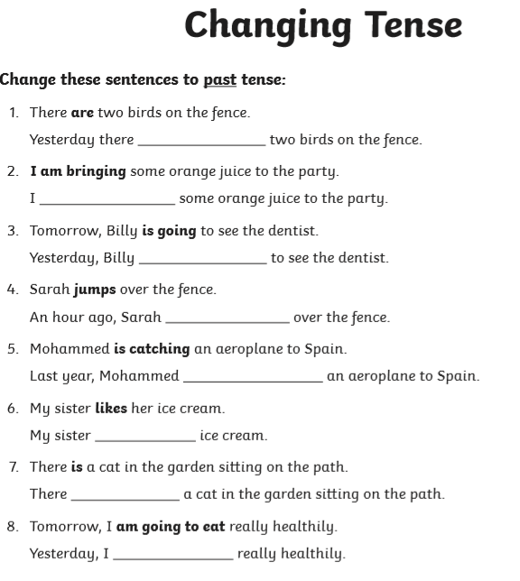
Task
Change the following sentences to make them past tense.
Have a go a writing a two short paragraph recounts of yesterday. Make one in the past tense and one in the present.

