Slide 1
Tuesday 28th April LO To investigate vocabulary
Finish reading the pages from yesterday, if you have not done so.
They tell of Lila and Lalchand’s display.
Could you make a picture in your mind from the author’s description?
What do you think a delayed action fuse is? Can you describe it?
Look up the words in red italics
Muffled
irresistible
Cascade
Were there any other words that you need to look up?

Slide 2
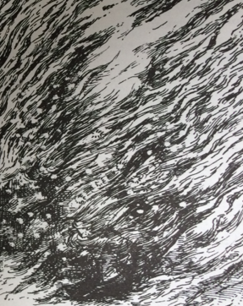
Find the descriptive words from the text.
Make a list of the descriptions from yesterday’s text
Sometimes there is just an adjective.
Sometimes there is a phrase which describes the action and the adverbs are very important.
In the next slide, you will be identifying similes, so don’t include those here.

Slide 3
Similes
Can you find the similes that the author has used to help the reader imagine the scene before him/her?
Go through the text and find as many as you can.
You would write your answer like this:
The flowers began to float across the
dark lake like little paper boats.
Hint:
There are at least seven!

