Slide 1
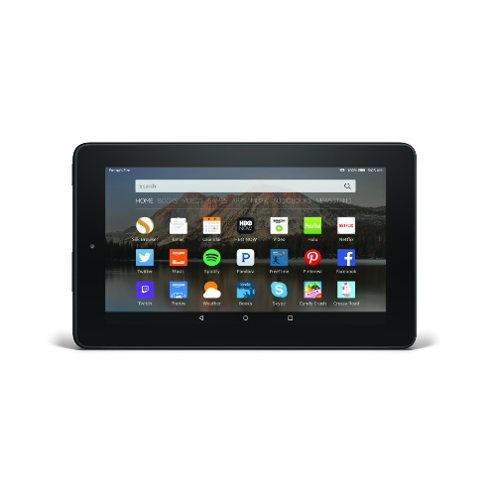
WEDENESDAY 13TH May
General Activity: technology
.
Over the next few days, it would be useful for you to gather evidence of your child exploring technology, and upload it on tapestry.
If you are not uploading onto tapestry- keep a written record.

Slide 2
Technology Expectations
To be Age expected: your child recognises that a range of technology is used in places such as homes and schools.
To be exceeding: children find out about and use a range of everyday technology. They select appropriate applications that support an identified need- for example in deciding how best to make a record of a special event in their lives, such as a journey on a steam train.

Slide 3
Questionnaire
Use the questionnaire (see website) as guidance for your observations.
Please complete by writing a brief example to support each question or upload a video/ photograph if it is more appropriate.

