Slide 1
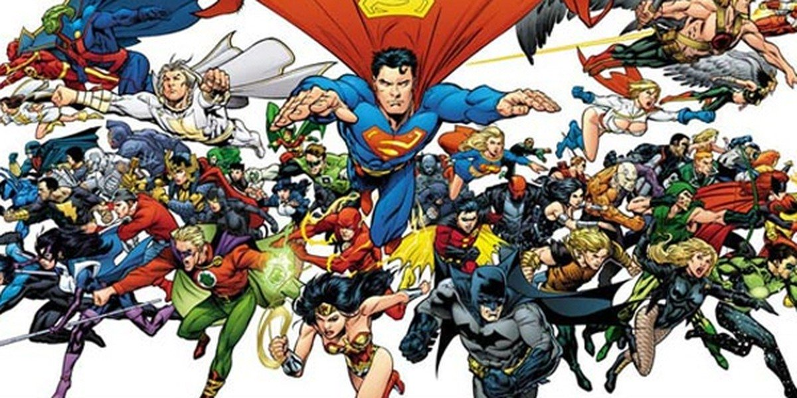
English Superhero Suspense
Thursday 21st May, 2020
LO: To develop a character

Slide 2
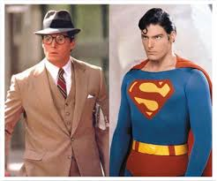
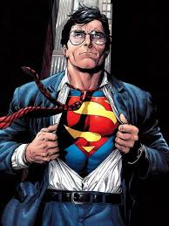
Superheroes
Today we are going to create and develop our own superhero character. Try to think carefully about your character, ask yourself lots questions about their appearance and personality. Think about what their past was like and perhaps even give them a shared, more human character, like the examples below.
For example Clark Kent is a journalist but can change into his Superman character.
Peter Parker becomes Spiderman.

Slide 3
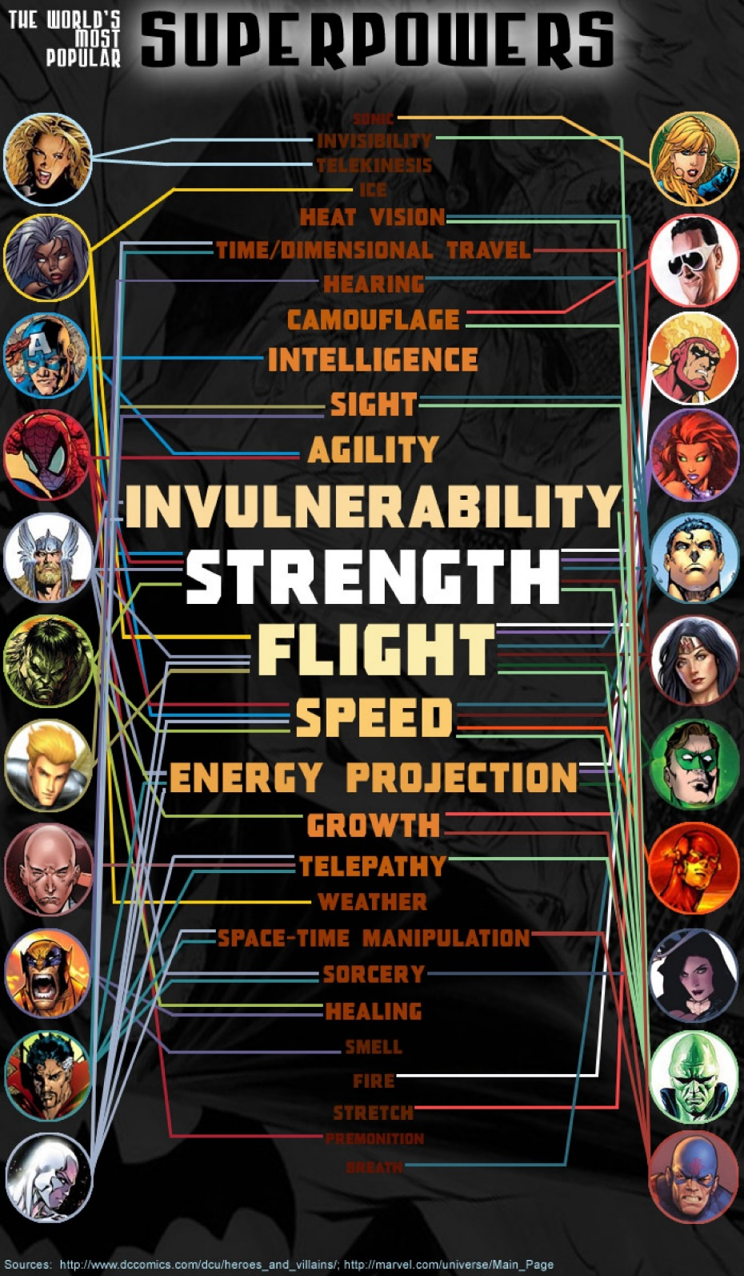
Special Powers
Have a think again about possible special powers they might possess? How could you use them in a story?
Look at the next slides to help you to develop your skills at creating characters. The better you know them, the more interesting they will be to the reader.

Slide 4
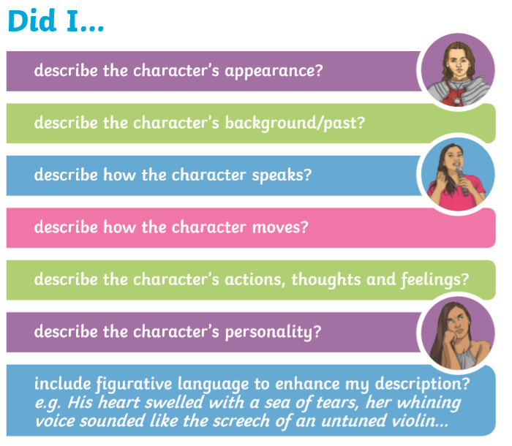
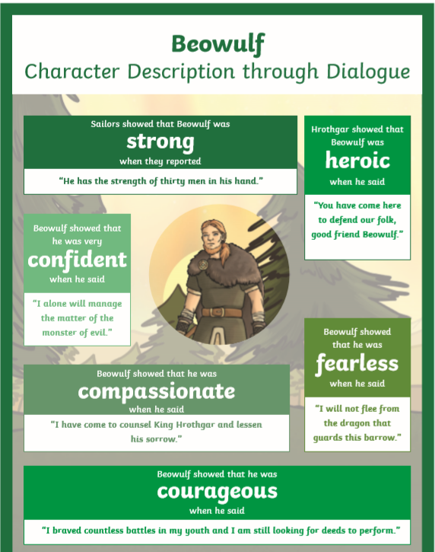

Slide 5
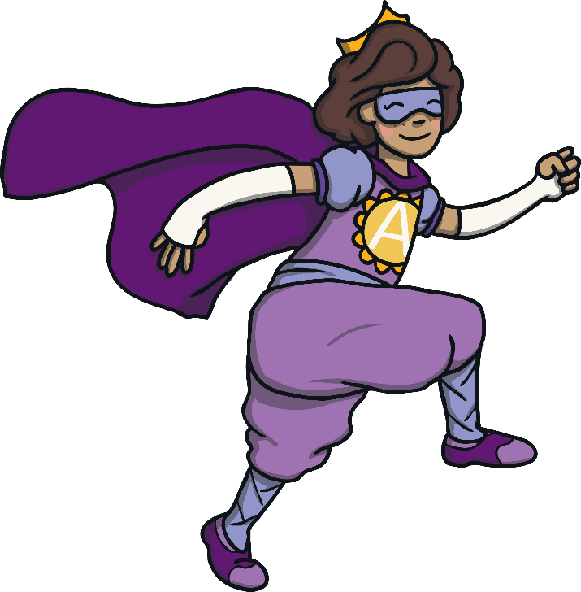
My Superhero
Today, we are going to design ourselves as a superhero.
Imagine you are going to become a superhero.
What would your superpower be?
How did you get your superpower?
What will you use your powers for?
What would your costume look like?
What colour would it be?
Would you have a cape or a mask?
Discuss your ideas with your partner.

Slide 6
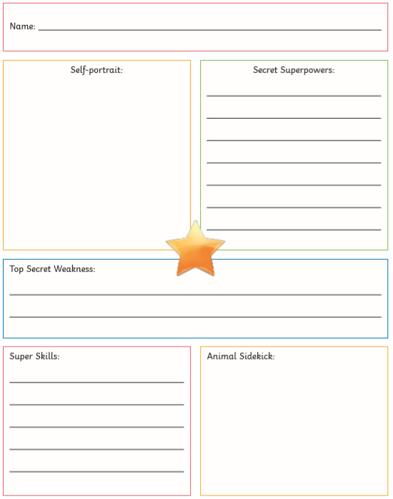
Task
Write a description of your hero.
You can use the format here
to help you, but make sure you go on to write about them in further detail.
Make sure to include a picture of them too!

