Slide 1
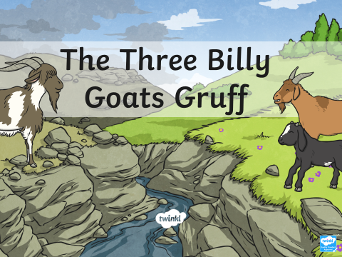
Tuesday 5th May
Literacy
.
Aim: this week children will explore the structure of traditional tales through the Three Billy Goats Gruff.
Throughout the week, we will:
Explore the structure of the traditional tales.
Explore characters.
Sequence the story.
Explore orally retelling their own version of the story.

Slide 2
Read the story
Access this at:
https://www.twinkl.co.uk/resource/t-t-5380-the-three-billy-goats-gruff-story-powerpoint
https://www.twinkl.co.uk/resource/tg-au-18-three-billy-goats-gruff-audio-book

Slide 3
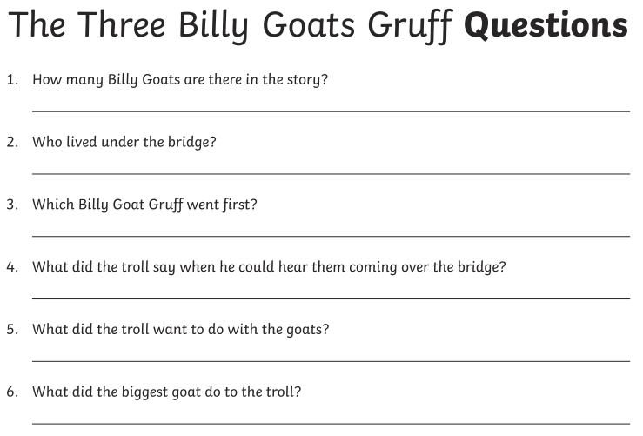
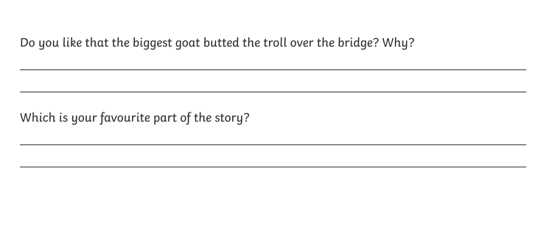
Questions Encourage your child to answer the questions verbally.
Challenge:
If your chid is not sure how to answer these, model it to them.

Slide 4
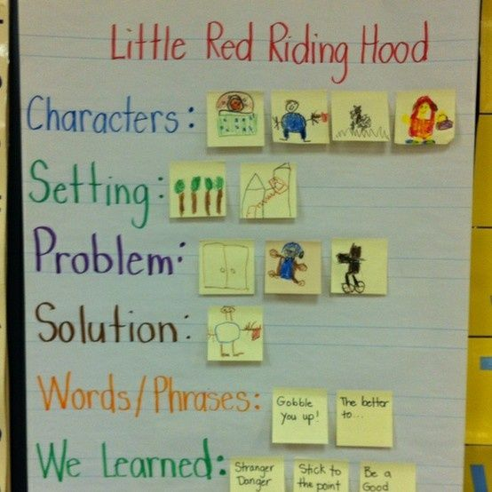
This activity will allow you to explore the structure of stories. The headings signal the key components of a story (this is an example of what you are going to do with your child).
Create a similar chart to ‘unpick’ the story of the Three Billy Goats Gruff.
Your child can draw the characters, but I also expect them to write key words and simple sentences phonetically. Please encourage them to do this.

Slide 5
Sequence the story
Using the sheet attached to the website encourage your child to sequence the story.
Encourage your child to label the pictures or write sentences to match the pictures. They do not have to do it for every picture- just main parts.
Check in with your child's writing
On the website, you will find information about writing stages for EYFS. Which stage do you think your child is at?
If your child is at stage 5 and 6, we encourage consistent finger spaces and spelling some red words correctly.

Slide 6
Key learning
Reading: Can describe the main events of simple stories in detail. Children can make simple inferences.
C&L Understanding: After listening to a story children can express their views about events or characters in the story and answer questions about why things happen.
Writing: Children are consistent at writing phonetically plausible sentences. They are consistently using finger spaces. They can read back what they write.

