Slide 1
Make 3D shapes
LO: To be able to identify and make 3D shapes.
Steps to Success
I can use the properties of the 3D shapes to name them.
I can use the properties of the 3D shapes to make a 3D shape.
I can name the properties of 3D shapes.

Slide 2
Once again discuss each slide with your adult. If you do not have cubes you could draw the shapes. Once you understand what the questions are asking you can then complete the worksheet.
You could challenge yourself and see how many 3D shapes you could make using straws and marshmallows.
Try not to eat too many marshmallows before you make your shapes.
Good Luck

Slide 3
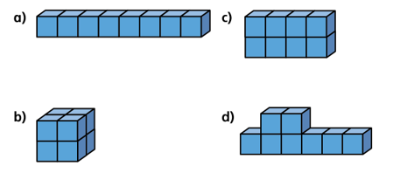
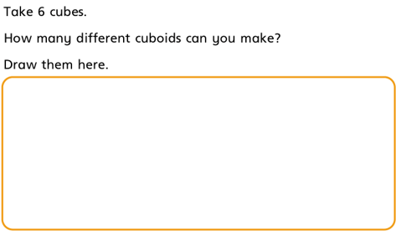
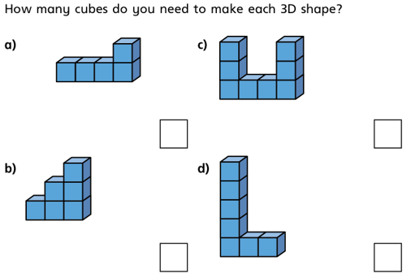

Slide 4
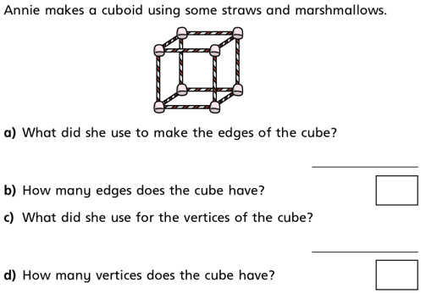
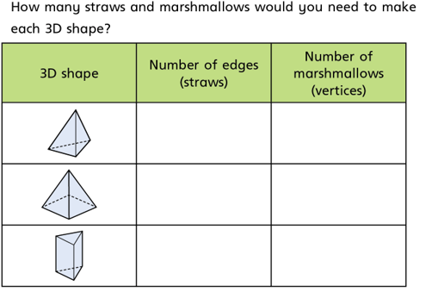

Slide 5
