Slide 1
Thursday 21st May 2020 LO To explore 3D shapes
SUCCESS CRITERIA
I can model 3D shapes.
I can know the terminology to describe 3D shapes
I can recognise and name 3D shapes.
ACTIVITIES
Work through the slides.
If you are able to print, use the nets to build the shapes.
Mathletics – Open the unit Properties of Shapes. Complete any of the units which you have not done. I have assigned them where I see that they have not been done.

Slide 2
Starter
Column calculations
4250 + 6325 – 439 =
8745 - 309 =
739 x 6 =
546 ÷ 6 =

Slide 3
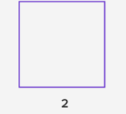
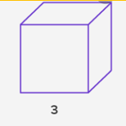
3D shapes
Three Dimensions
Think of a little dot in space
It stretches into a line. The line may be horizontal or vertical.
This is a one dimensional shape.
The line stretches in another direction – now there are 2 dimensions.
When we add another direction – depth, we have a 3 dimensional shape

Slide 4
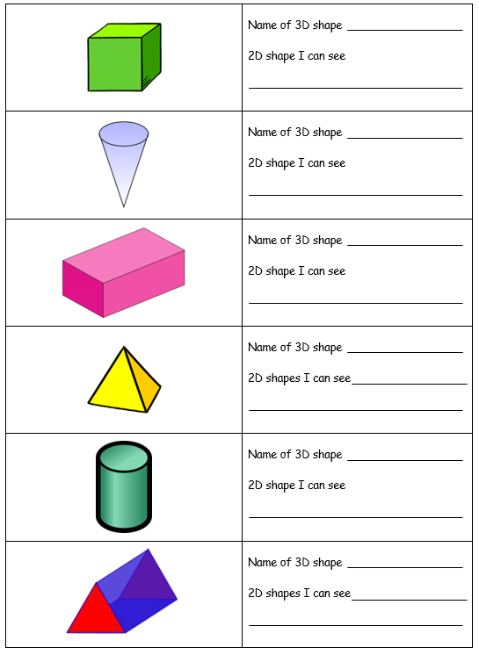
3D shapes
Which shapes do you know?
Can you find them?
Triangular prism
Pyramid
Cylinder
Cube
Cone
Cuboid
Think of real life objects which have these shapes.

Slide 5
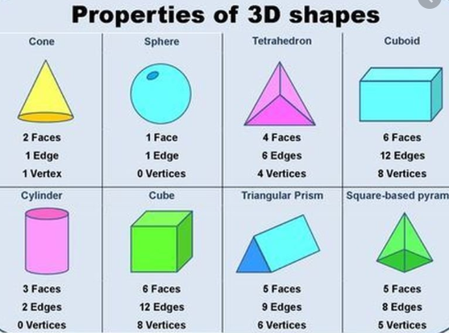
Look at the properties of 3D shapes.

Slide 6
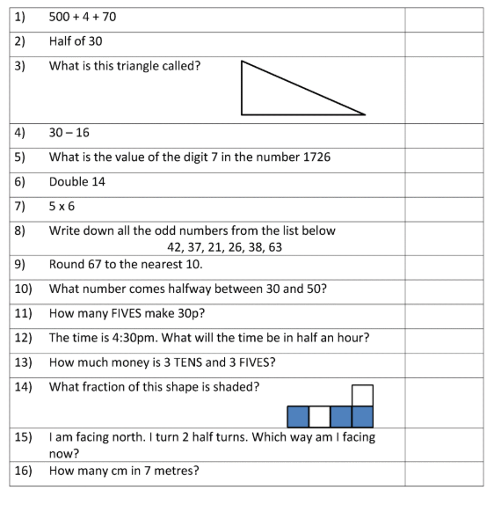
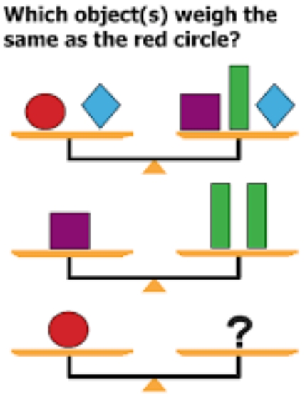
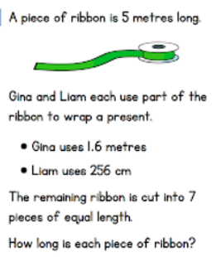
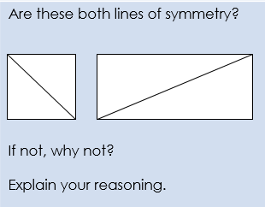
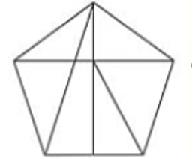
Quiz time
Challenge:
How many triangles can you find?

