Slide 1
Comparing Angles
LO: to identify different angles and their range of degrees.
Steps to Success
I can name the different angles and know their degrees range.
To draw the different types of angles and name them.
I can explain my reasoning.

Slide 2
Different types of angles. You will need to understand these angles in order to answer the questions. Look at the last box and it shows that 360 degrees. Then it explains what each angle is called and what degrees it could be between.

Slide 3
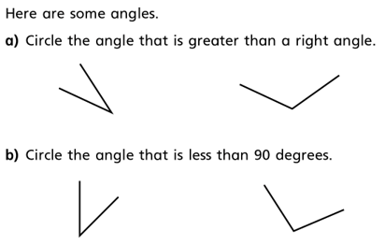
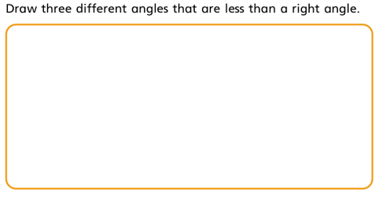
Look carefully at the angles as they may have been rotated so they might have two straight lines.
Look at the first slide to help you solve this question.

Slide 4
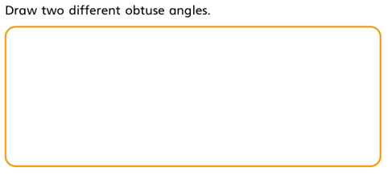
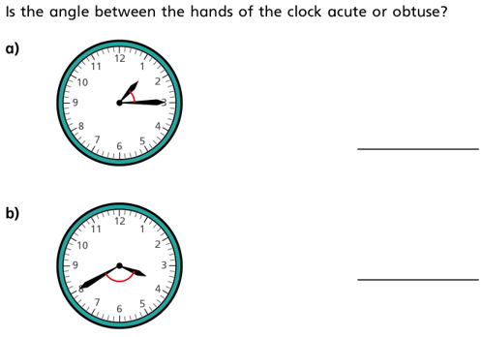
Discuss your reasoning with an adult. Use the first slide to support your answers.

Slide 5
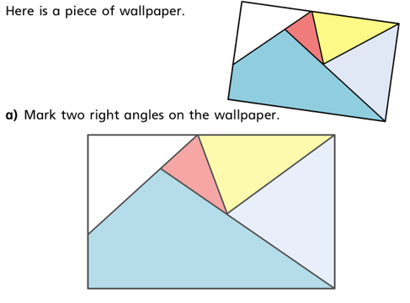
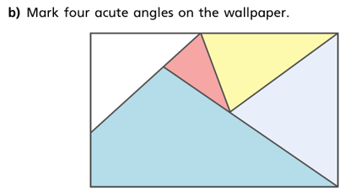
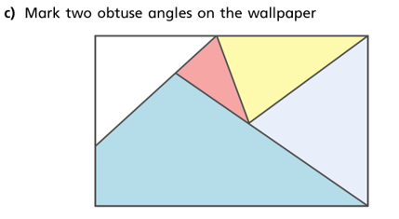

Slide 6
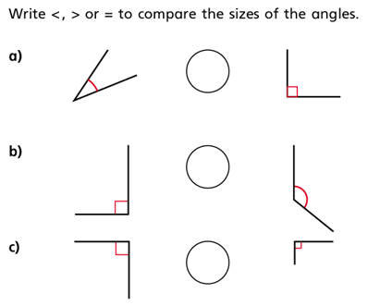
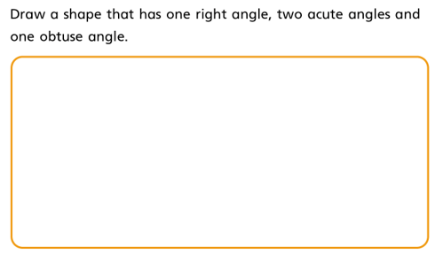
Once you have completed this question do you think you could produce on e for your adult to complete.
REMEMBER you must know the answer.

