Slide 1
Thursday 21st May 2020 LO To recap properties of shape, lines and angles
SUCCESS CRITERIA
I can build shapes from the information provided.
I can apply my knowledge of lines and angles.
I can work accurately with lines and measuring.
ACTIVITIES
Work through the slides.
Work through all the worksheets Mild, Hot and Spicy – as far as you can go.
Mathletics – times tables games

Slide 2
Starter
TERMINOLOGY:
Lines – parallel – Have you remembered horizontal and vertical?
Perpendicular where one line meets another, forming a right angle.
Angles – acute, obtuse and right angles.
Shapes – various regular and irregular polygons.
Triangles – isosceles, equilateral and right angled.
Halving and Doubling
Find half of 2
Find half of 30
Double 250
Halve 2250
Double 375
Halve 700
Halve 3
Halve 15

Slide 3
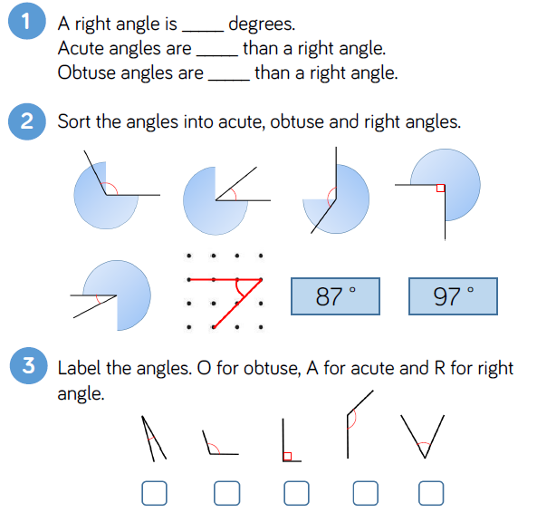
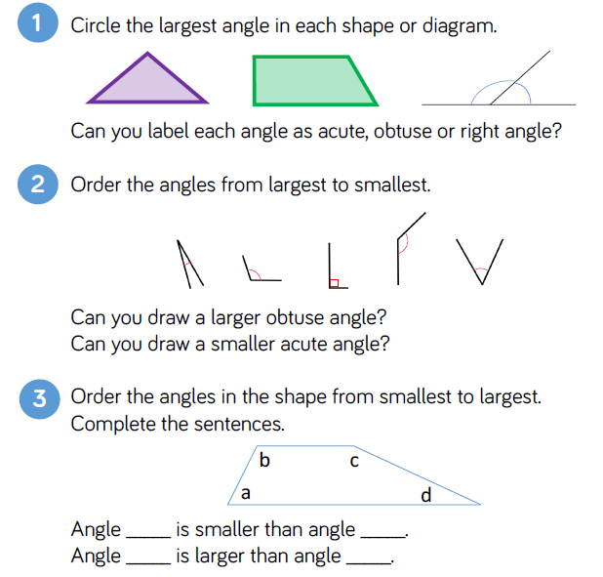
Size of angles

Slide 4
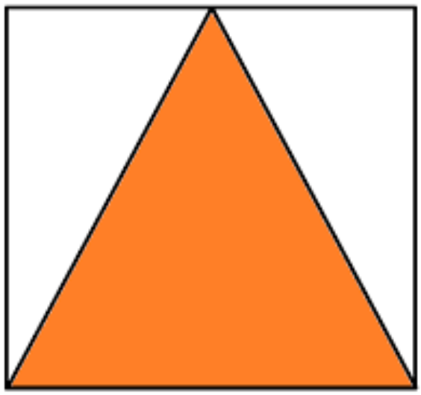
Following instructions
Draw a horizontal line of 10cm. Draw another vertical line perpendicular to your horizontal line. This should be 5cm long.
Draw a rectangle 10cm by 5cm.
Draw an equilateral triangle. 1 side measures 6cm.
What is the sum of the sides of this equilateral triangle?
One side of the square measures 7cm.
5. Is it possible to draw a quadrilateral with 2 right angles and
3 sides of equal length? Convince me by drawing a picture to help.

Slide 5
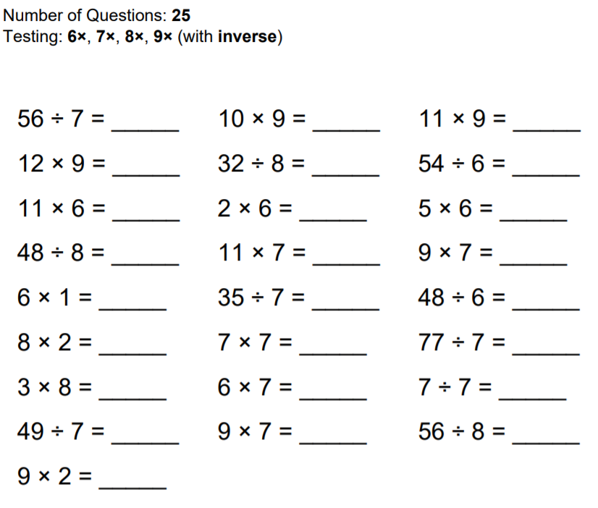
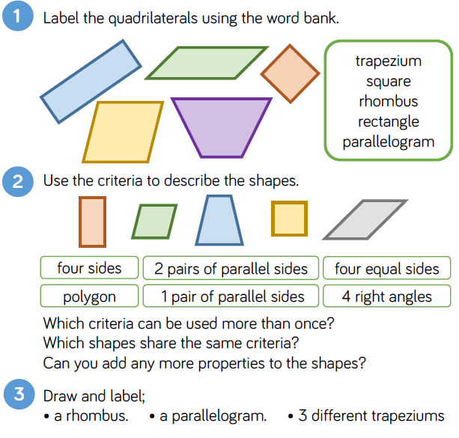
Quadrilaterals
Keep trying to finish under 1 minute.
Speed test

