Slide 1
Monday11th May 2020 LO To solve problems using the four operations.
SUCCESS CRITERIA
I can decide which operation to use in a word problem
I can use formal methods to do the operations.
I know the terminology for the operations.
I know how to add, subtract multiply and divide.
ACTIVITIES
Work through the slides. Do any calculations on a slide.
Work through the worksheets – Mild, Hot and Spicy – as far as you can go!
3. Practise tables on Mathletics – no speed test today.

Slide 2
Starter
Did you remember the terminology?
Product – answer to a multiplication problem.
Quotient – answer to a division problem.
Total or sum means the answer to an addition problem.
Finding the difference means you must subtract.
Solve the number problems:
Find the sum of 1342 and 3679
What is the total of 7654 and 1999?
What is the difference between 3201 and 1999?
Find the quotient for this division problem 345 ÷ 5?
What is the product in this problem 568 x 7?
How many wheels do 367 cars have?

Slide 3
Read all word problems very carefully.
Read and understand the problem. What must you find out?
The word problems that you will be doing now could involve any of the four operations.
Sometimes you will have to do two operations to solve them.
Remember to use your Maths and Literacy skills and follow these steps.
What numbers must you use?
What operation must you use?
If you are not sure, substitute smaller numbers. Usually you can work out the answer in your head, but you are not quite sure if you added or subtracted to get that answer. With smaller numbers, you can see what you did.
If you are not certain, draw a picture of the problem.
Do the calculation and write down the answer. Remember to include the item e.g. the answer to no.6 was a certain number of wheels.
Check your working out.

Slide 4
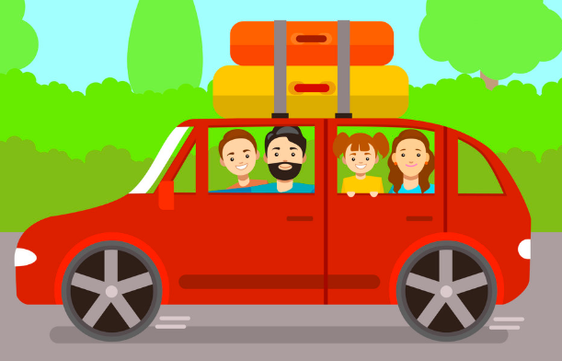
Use the steps with this problem
The Jones family are going on a long journey. They travel the following distances over 3 days. How far have they travelled altogether?
Day 1 - 359 km
Day 2 - 432 km
Day 3 - 299 km
What must you find out?
How far the family has travelled
2. What numbers must you use?
359 and 432 and 299.
3. What operation must you use?
Addition
If you were uncertain, let’s say that the family travelled 1 km, then 2km and then 2km. How many kilometres have they travelled?
You would know immediately that they had travelled 5km. What operation have you used?
Addition.
If you wanted to draw a picture, you could do a line showing the distances travelled.
Do the calculation. Your answer will be in kilometres.
Check your working.

Slide 5
Sometimes the problem has two parts.
Try this one before doing your worksheets.
Their destination is 1500km from their home. How far must they still travel?
In this case, you would have to find the distance that they travelled and subtract that from the entire journey.
1500 – (359 km + 432 km + 299 km)
Lily has £8.00 to spend. She chooses a pack of cards for £2.99 and Mother’s Day chocolates for £3.98 . How much money will she have left?
Try to work it out before clicking for the answer.
First you will need to calculate what she spent by using addition and then what she has left by subtracting.
2.99 + 3.98 = £6.97
8.00 – 6.97 = £1.03

