Slide 1
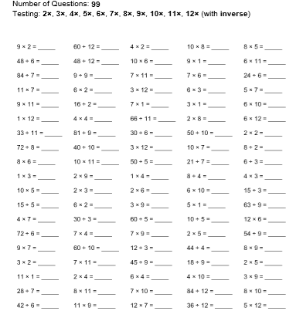
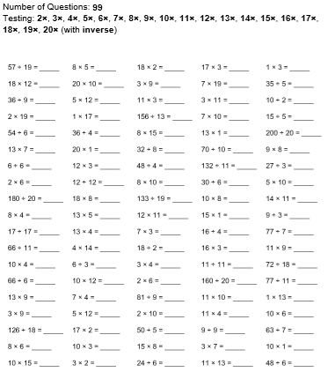
To understand the difference between Regular and Irregular Polygons
22.05.20
How many can you complete in 5 minutes? Can you beat your score from yesterday?
Mild/hot
Spicy

Slide 2
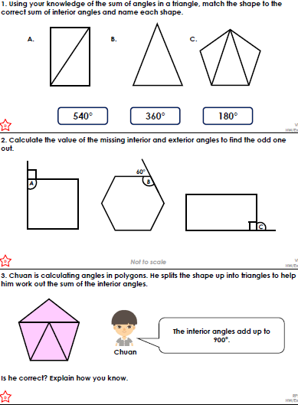
Answers

Slide 3
On the website there are Mild, Hot and Spicy Angles questions.
I would like you to spend at least the next half an hour working through the questions.
I have uploaded the answers which contain notes on how to complete the question if you require more support
Complete the next numeracy ninja

