Slide 1
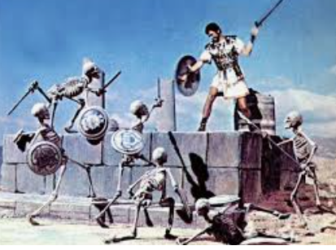
boulder heave forget remember crush destroy defeat
victorious victory success successful
first task celebrate
one step closer
golden fleece
Robotic skeletons hideous skinless creatures nasty shields crushing battling striking menacing surrounded overwhelmed every direction
Wednesday 20th May 2020
LO:- To write a paragraph of a persuasive letter
Steps to Success:-
I can use a rhetorical question.
I can use emotive language.
I can use alliteration.
I can use facts.
I can use opinions.
I can use repetition.
Wise wonderful
Wisdom helpful
Grateful thankful
awesome
loyal honest
Magical

Slide 2
Persuasive Devices
Can you match each box with its letter?
Strong, wise and magical are my ideas.
A
How can you defeat the skeleton soldiers?
lliteration
Their swords are twenty metres wide.
F
acts
O
pinions
I know how to defeat the skeleton army.
R
R
epetition (& hetorical Questions)
E
E
Normally, men are killed by the terrible skeleton soldiers.
motive Language (& xaggeration)
S
I am the wisest woman in Europe.
tatistics
T
hree (rule of)
I can help you with your first task. I promise to help you with the first task.
I am wonderful and wise.
I think the boulder will crush them.

Slide 3
Persuasive Devices
Can you match each box with its device?
Strong, wise and magical are my ideas.
T
How can you defeat the skeleton soldiers?
R
A
Their swords are twenty metres wide.
E
lliteration
I know how to defeat the skeleton army.
F
F
acts
O
pinions
R
R
I am the wisest woman in the world.
E
epetition (& hetorical Questions)
E
E
.
Normally, men are killed by the terrible skeleton soldiers.
S
motive Language (& xaggeration)
S
tatistics
T
hree (rule of)
I can help you with your first task. I promise to help you with the first task.
R
I think the boulder will crush them.
O
I am wonderful and wise.
A

Slide 4
Click to listen again.
Today you are going to write sentences to explain to Jason, why you Medea can help him with the first task. Explain to Jason, what the task will involve. What he will have to do and how he can defeat the skeletons. Listen to the story again from yesterday if it helps. Use the FOREST devices. You want Jason to realise, only you Medea can help him.

Slide 5
Extra Challenge
Write down in the past tense, what happened, when the dragon seeds were planted and why Medea was so amazing. Use AFOREST to persuade the reader, that Medea was awesome
Mild
Talk about what happens when Jason plants the dragon seeds in the ground.
Then pretend you are Medea. Tell Jason in three sentences how you can
Help him.
What happens to soldiers normally when they plant the seeds?
Describe the soldiers, use a strong adjective.
Describe yourself, say how amazing you are. Try and use two adjectives.
Hot & Spicy
Use AFOREST devices to persuade Jason, that you can help him defeat the skeletons and succeed in the first challenge. Try to write at least five sentences. Use strong adjectives, alliteration, a rhetorical question and as many of the other devices as you can. Remember you are Medea, writing to Jason to persuade him, to let you help him.
Use your plan and word bank from Monday to help you.

