Slide 1
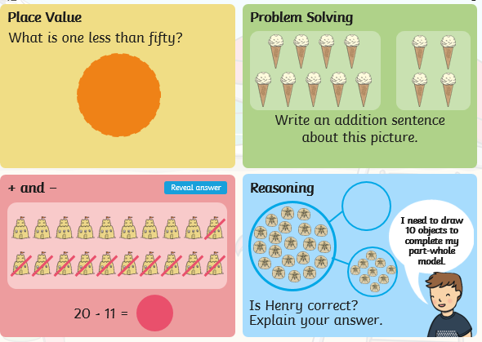
Wednesday 20th May: Partitioning Problems
Starter:

Slide 2
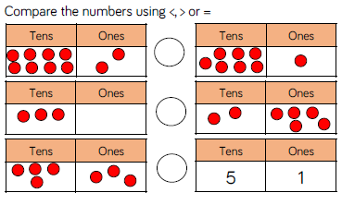
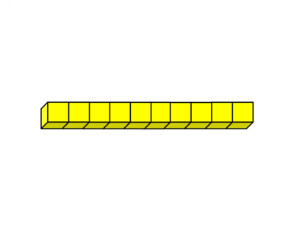
Today we are going to use all of the skills we learnt yesterday when partitioning to be able to solve problems.
Our first question is asking you to compare the numbers.
Each number has been grouped into tens and ones. First work out the numbers and then compare them.
Remember when we compare we use symbols:
< means less than
= means equal to
> means more than
I will leave the base 10 blocks on some pages in case you need to use them.

Slide 3
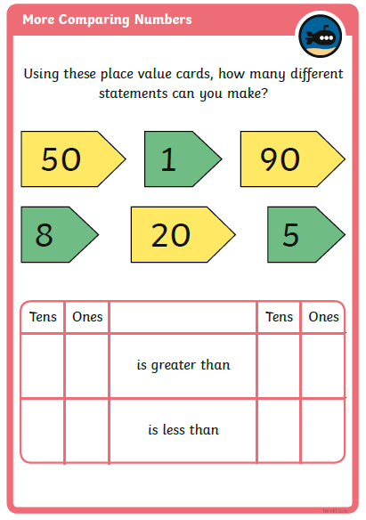
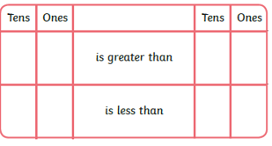
This question is also asking you to compare numbers.
This time, numbers have already been partitioned using place value cards, do you remember using these in school?
Make as many different numbers as you can using the place value cards, and then compare them look at my example below using different numbers.
40
70
3
6
4
6
4
3
4
3
7
3

Slide 4
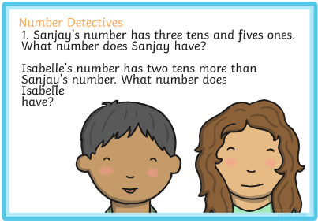
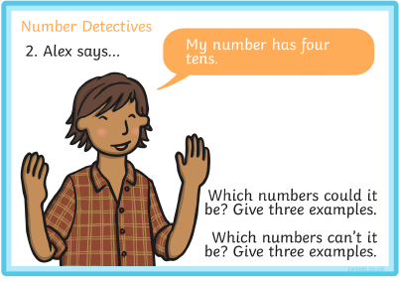
Now we are going to be number detectives, your job is to find the missing number that the problem is describing.

Slide 5
Can you solve these problems?

