Slide 1
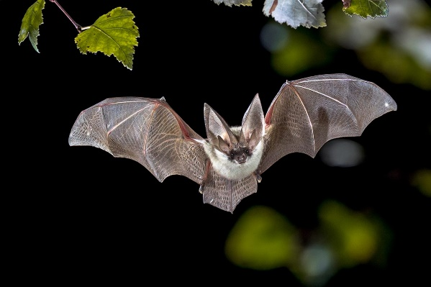
Friday 15th May
As we have been reading about what happens at night, today we are going to learn a bit more about bats.

Slide 2
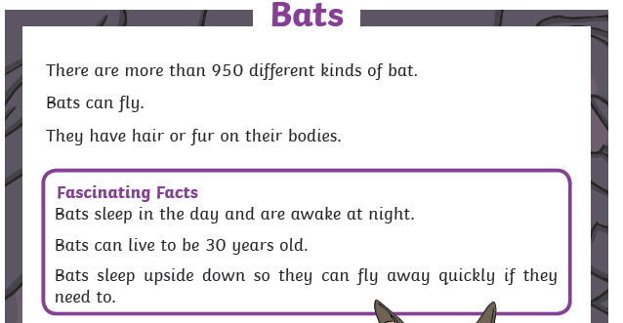
Try your best to read it yourself remembering all your phonics sounds.

Slide 3
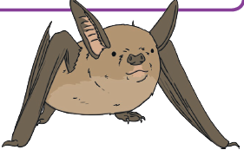
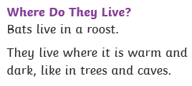
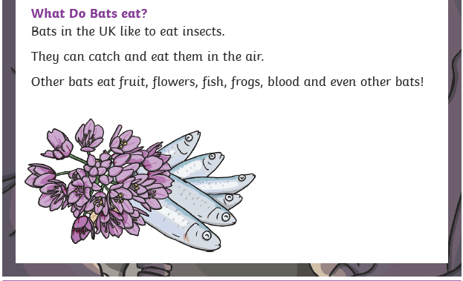

Slide 4
Questions
Try to answer these questions in full sentences, look at my example below.
How many different types of bats are there in the world?
Answer: There are more than 950 different types of bats in the world.
Instead of answering 950, I put my answer in a full sentence.

Slide 5
Questions
What do bats do in the day?
How old can bats live to?
Why do bats sleep upside down?
Where do bats live?
What do bats in the UK eat?

