Slide 1
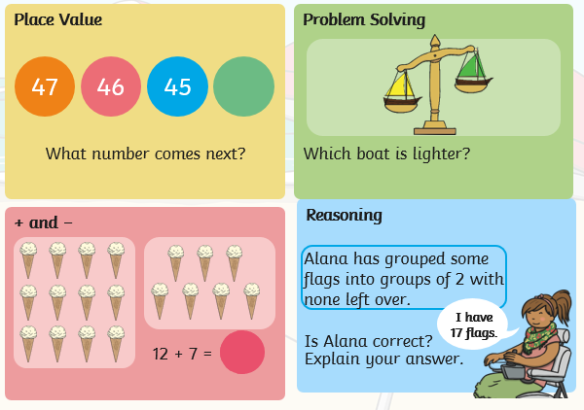
Tuesday 12th May: Counting Back from 100.
Starter:

Slide 2
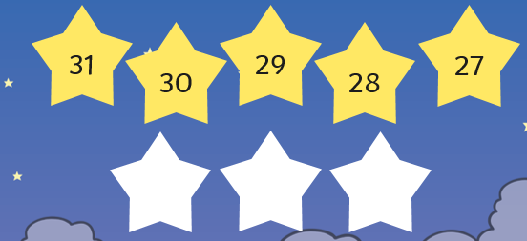
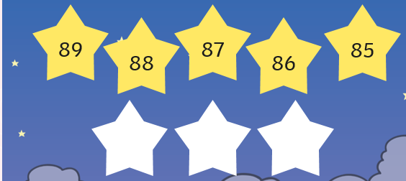
Today we are going to practice counting back. Before we begin you could warm up by counting with the supermovers: https://www.bbc.co.uk/teach/supermovers/ks1-maths-counting-with-john-farnworth/zbct8xs
Decide whether the stars are counting forwards and backwards and then work out the 3 missing numbers.

Slide 3
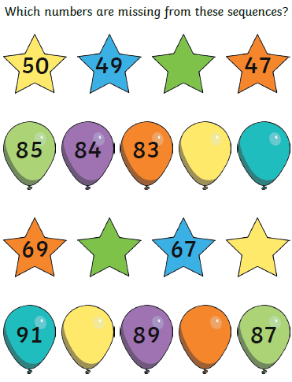
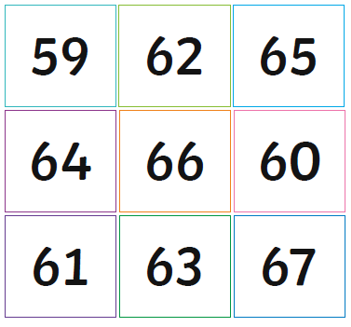
Choose your chilli challenge:
Arrange these numbers from greatest to smallest.
Can you continue counting backwards to find the next 5 numbers?

Slide 4
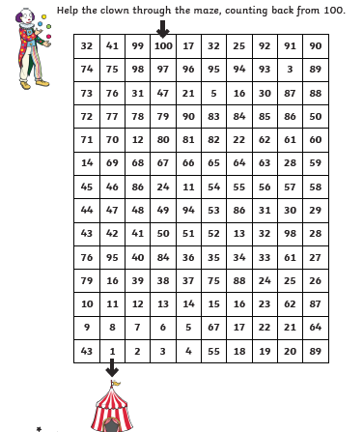
Count backwards to help the clown through the maze and back to his tent.
Notes:
71, 25, 42, 15, 9

Slide 5
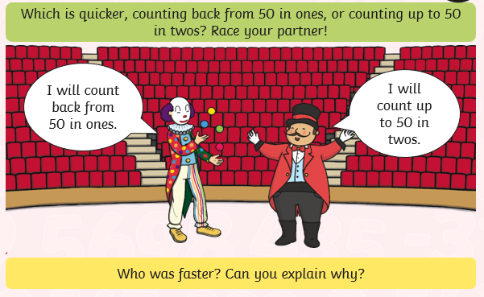
Extra Challenge:
If you would like more counting practice there is an activity assigned on Mathletics.

