Slide 1
Right Angles
LO: To identify a right angle and say how many right angles are in the shape.
Steps to Success.
I can recognise how many right angles are in shape.
I can say how many right angles there are in a directional turn.
I can give reasons for my answers.

Slide 2
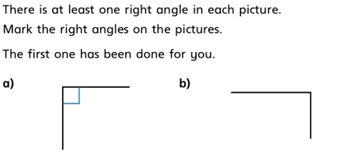
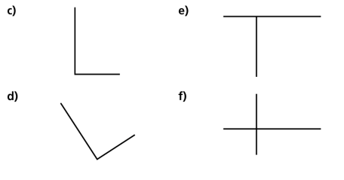
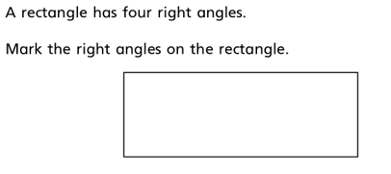
Remember that a right angle is where two straight lines meet. The lines have to be vertical and horizontally straight and not and an angle themselves.
Check if all the lines are straight if they are you can identify where the lines meet and place the right angle there.

Slide 3
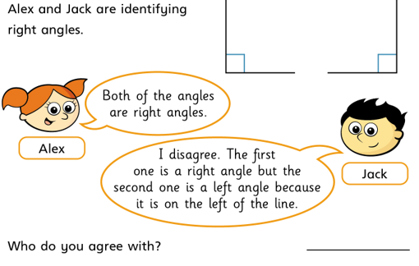

Slide 4
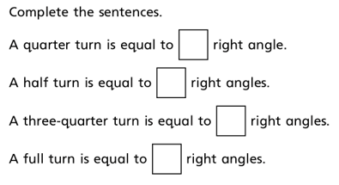
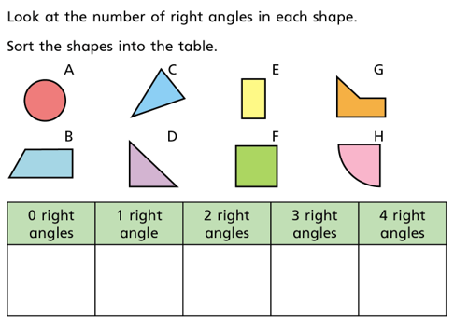
Discuss with your adult how many fight angles would be in each directional turn. This will help you to answers these statements.
Once again remember that the lines that meet have to be straight and not at an angle.

Slide 5
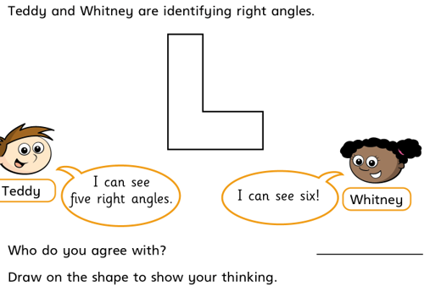
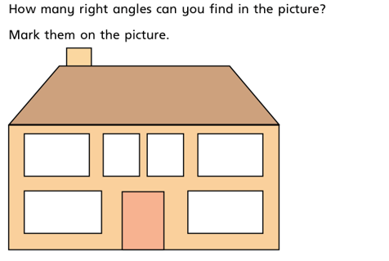
You could do a problem like this for your adult. BUT remember you must know the answer yourself.

