Slide 1
2D Shape
LO: To identify and name 2D shapes.
Steps to Success
I can name a variety of 2D shapes.
I can explain if an answer is incorrect.
I can say which shape is a quadrilateral

Slide 2
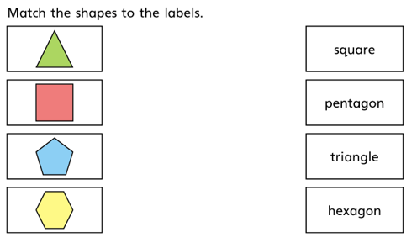
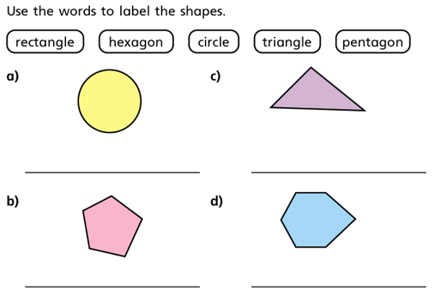
Let’s recap on the names of our 2D shapes.

Slide 3
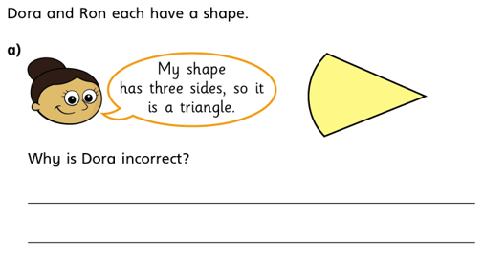
Please give clear reasons for your answer.
Use as much mathematical vocabulary as possible.

Slide 4
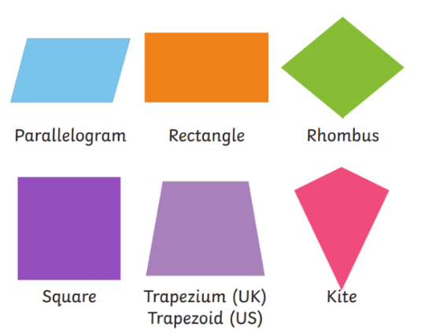
Use this information to help you solve the next few slides.
Examples of Quadrilaterals:
Shapes that are quadrilaterals are:
parallelogram
rectangle
rhombus
square
trapezium
kite
What is a Quadrilaterals
Quadrilateral means a shape that is four-sided.
'Quad' means four and 'lateral' means sides.
A quadrilateral is a 2D shape that is closed with four straight sides.
Quadrilaterals have four vertices with interior angles that add up to 360°

Slide 5
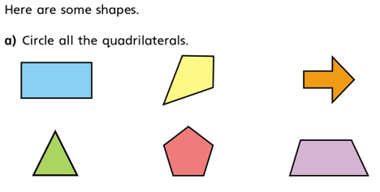
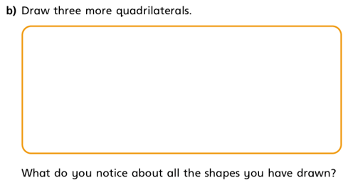
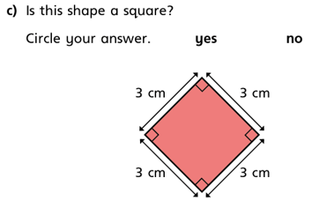
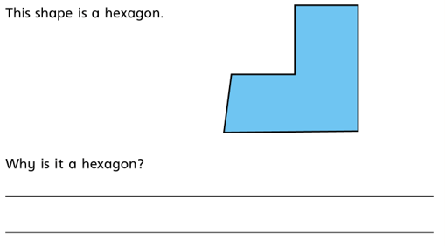

Slide 6
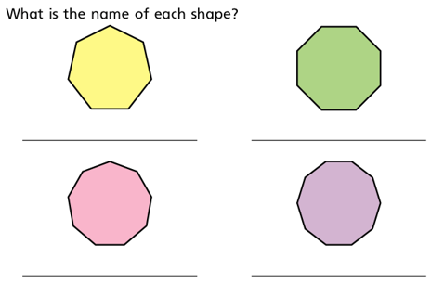
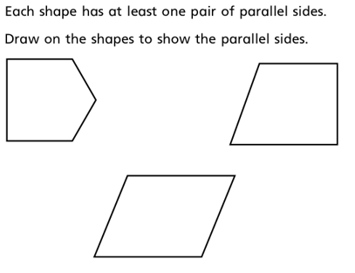
Look at the previous slide to recognise what a quadrilateral is.
Look at previous work to remember what parallel lines are

