Slide 1
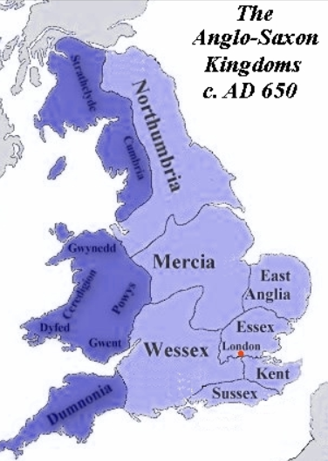
Anglo-Saxon England – The Warrior Queen
Wednesday 20th May 2020
LO To compare features of a text.
The writer of yesterday’s story was careful to point out that it is not known which parts of the story may be true.
We know that the people existed because we can find a record of them and who married who. There are a few records kept as chronicles of the time, so we know that there is a certain amount of evidence. King Alfred’s biography was written while he was still alive.
We know that the Anglo-Saxons finally managed to get control of their country. And went on to fight other wars and get defeated at a later stage.
As far as our text goes, there are some clues as to the parts that are true and which have been made up.

Slide 2
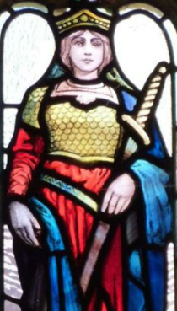
Legend or fact?
The Warrior Queen
The writer uses features like:
“The story goes ….”
“According to legend…”
“Once again the legend tells …”
These strategies are useful when a writer cannot verify the facts. There might be some evidence but the writer is not too sure of the facts. When the facts are clear, then the writer can feel safe to use them in a story.
Sometimes it is very clear that the story is a legend, for example the story of Beowulf which we did earlier in the year.
When answering the questions, you will need to find evidence in the text.

Slide 3
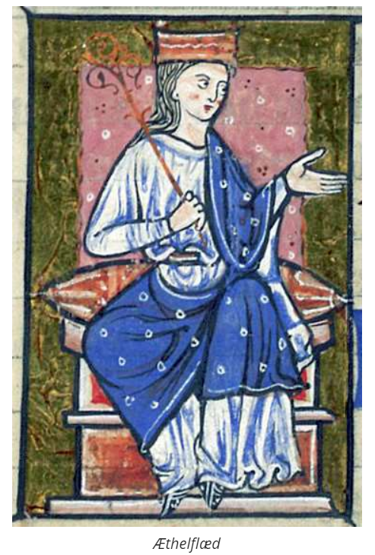
True or false?
The Anglo-Saxon alphabet had some different letters to ours.
King Alfred was known as Alfred the Great at this time.
Æthelflæd married when she was only sixteen.
They had a child called Ælfwynn, who was a giant.
The Danes had taken over large parts of England.
Æthelred fought at the battle at Chester.
Æthelflæd had a brother called Edward .
Go to the next slide for possible answers. Your answers may be different because you have found other information.

Slide 4
Answers
The Anglo-Saxon alphabet differed from the one we use today. One example is this ‘Æ’, which we read as ‘e’, and it was called ‘ash’. But if you did some research you would have come up with the Runes used by the early Anglo-Saxons and lots of information about writing in these times. The Old English that they would have spoken is very different to the English language that we speak today.
We are told that historians began calling him Alfred the Great.
We would know from the records when Æthelflæd
No mention is made that the child, called Ælfwynn, was a giant. We know that giants do not exist
The Danes had taken over large parts of England, which we know from historical records.
There is historical evidence that Æthelred was too ill to fight at the battle at Chester.
Æthelflæd had a brother called Edward and we know this from historical records.
Over the years, the runes merged with the Latin alphabet so that the writing used at this time looked like the example below.

