Slide 1
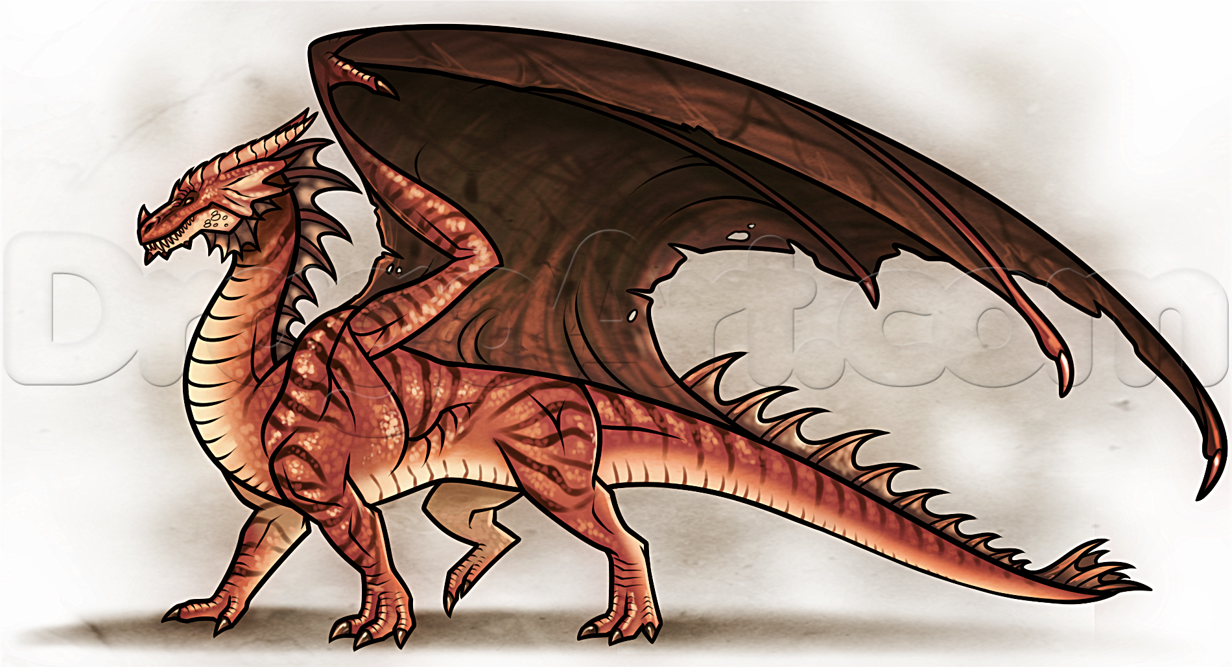
Tuesday 2nd June 2020
LO:- To create a word bank, to describe a dragon.
Steps to success:
I can use fronted adverbials.
I can use alliteration.
I can use similes.
I can use imaginative, descriptive verbs.
I can use imaginative, descriptive adjectives.

Slide 2
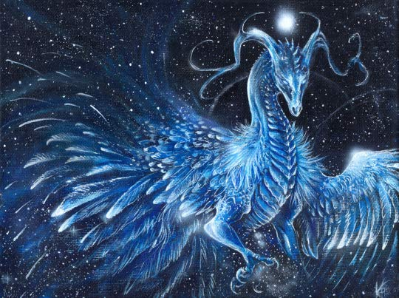
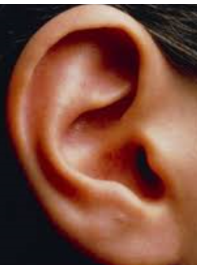
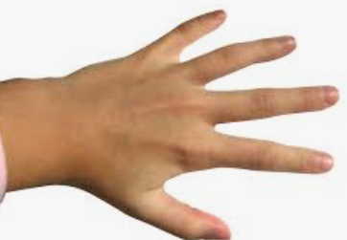
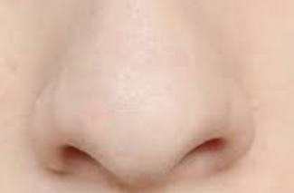
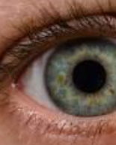
What can you hear?
What can you smell?
How does it feel?
What can you see?

Slide 3
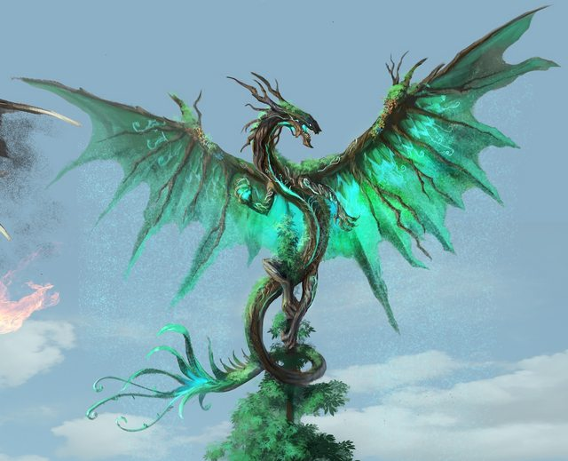
Listen to this extract from, ‘How to train your dragon.’
Similes
As black as …
As sharp as…
As clever as…
As shiny as..
As ugly as..
Gleaming like..
Roaring like..
Slithering like..
Beating like…
Openers
Swiftly
Without hesitation
Diving through
Soaring upwards
Plunging into the ocean
Encircling the Vikings
After scraping his talons
Verbs
Wriggle writhe pulsate
Stare beat swoop breath
Swoosh surround circle
Dive squash burn torch enflame
Engulf squawk scream roar flap
rake squeal clench rake scramble
Grip yelp

Slide 4
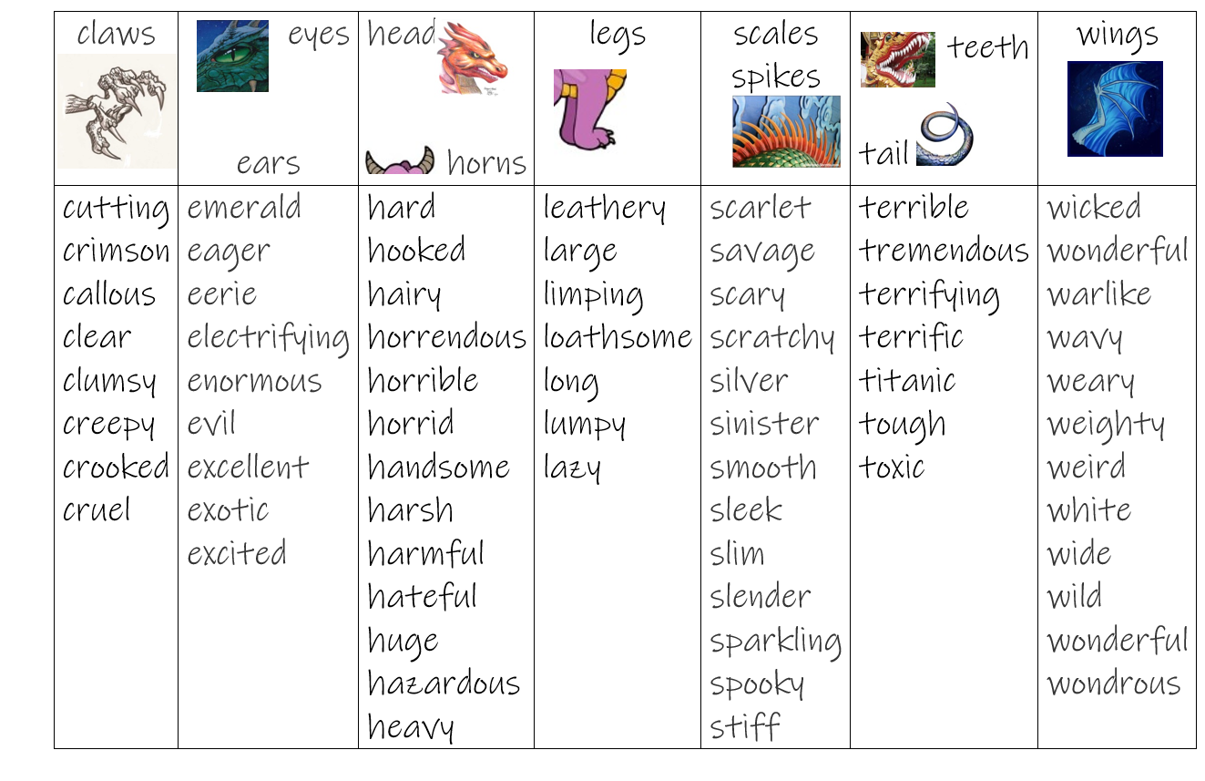
Adjectives

Slide 5
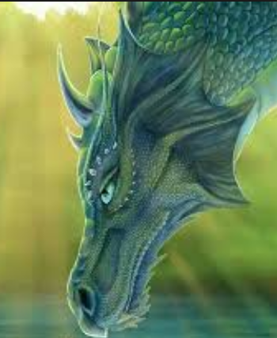
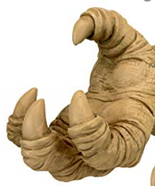
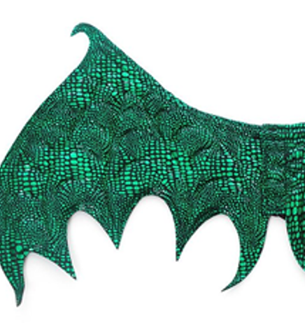
Extra challenge. Write sentences about your dragon.
Mild
Make a word bank to describe a dragon.
Include adjectives, verbs and similes if you can. Write at least 10 adjectives and verbs. Write out at least three similes.
Hot & Spicy
Create a word bank, to describe a dragon, include at least:-
15 descriptive adjectives
15 powerful verbs
8 similes
Some openers or fronted adverbials.
Use alliteration.

