Slide 1
24.06.2020
Menu
Fluency
Complete these questions.
Problem Solving
What is the difference between people who liked cats the most and dogs the most?
1. 827 ÷ 1 =
2. = 462 - 284
3. 144 ÷ 9 =
4. 27 × 36 =
5. 384.48 + 85.47 =
6. 1.08 × 10 =
827
Reveal answer
9391
Reveal answer
Animal | Frequency
Dog | 37 483
Rabbit | 8727
Cat | 28 092
Hamster | 24 984
178
Reveal answer
16
Reveal answer
972
Reveal answer
Reasoning
469.95
Reveal answer
457 924 406
Which is the odd one out? Give your reasoning.
10.8
Reveal answer

Slide 2
Menu
Fluency
Complete these questions.
Problem Solving
Write the two missing value to make these equivalent fractions correct.
407
1. 407 × 1 =
2. = 48 × 36
3. 486 ÷ 3 =
4. 100 × 638 =
5. 5 – 1.15 =
6. 1320 ÷ 12 =
Reveal answer
Reveal answer
1728
4
12
18
Reveal answer
=
=
8
24
36
162
Reveal answer
63 800
Reveal answer
Reasoning
3.85
Reveal answer
Nikita says, “Adding two odd numbers always makes an even number. “
Is she correct? Explain your reasoning.
110
Reveal answer

Slide 3
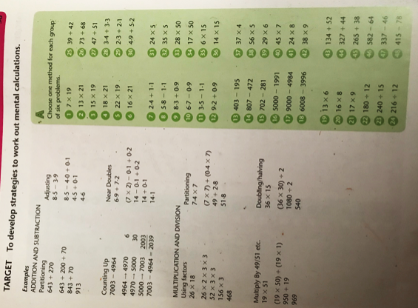
Mild

Slide 4
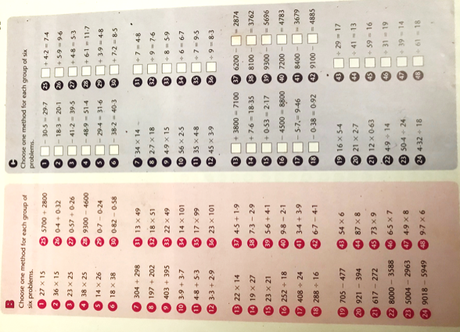
Hot
Spicy
÷ 29 = 17
÷ 41 = 13
÷ 59 = 16
÷ 31 = 19
÷ 39 = 14
÷ 61 = 18

Slide 5
