Slide 1
Wednesday 17th June Around the World in 80 days!
Adding the prefix ‘un’ to root words
Read each sentence. Add ‘un’ to the word in bold and complete the sentences by writing in the word.

Slide 2
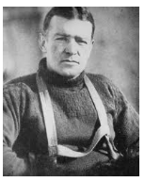
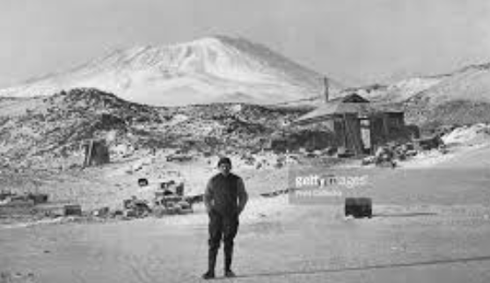
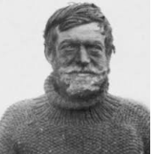
Today we are learning about the explorer Ernest Shackleton
In 1901 Shackleton joined Captain Scott’s exploration of Antarctica, but had to come home as he became very ill.
In 1908, he returned to the Antarctic as the leader of his own expedition, on the ship 'Nimrod'. During the expedition, his team climbed Mount Erebus, a volcano and made many important scientific discoveries
In 1914, Shackleton went back to the Antarctic for the third time, aiming to cross Antarctica completely, stopping at the Soiuth Pole on the way.

Slide 3
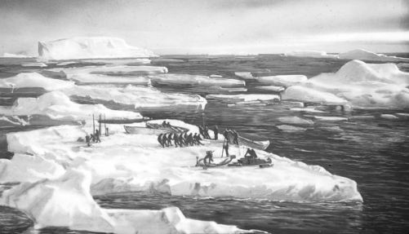
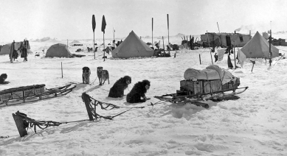
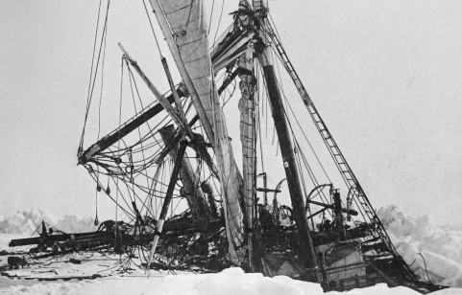
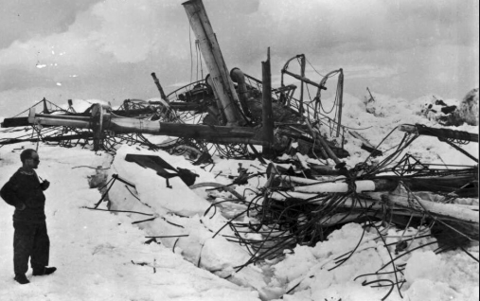
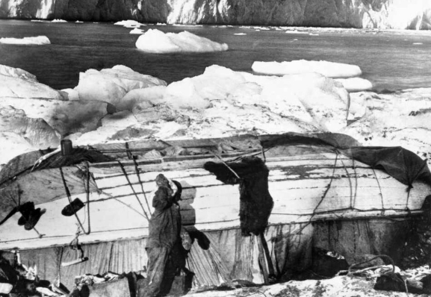
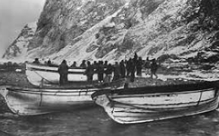
On his last voyage, Shackletons ship, The Endurance, became trapped in the ice and was eventually crushed!
Shackleton and his men had to camp on the ice floes, thick sheets of ice that drifted. They camped on these for over 5 months.
Here they made camp using the upturned life boats. They had to eat seals and penguins.
Eventually Shackleton and his men climbed into 3 small life boats and reached Elephant Island.

Slide 4
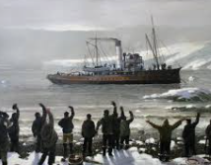
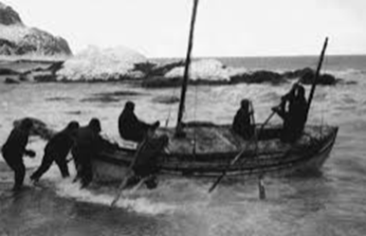
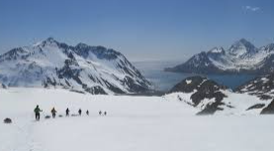
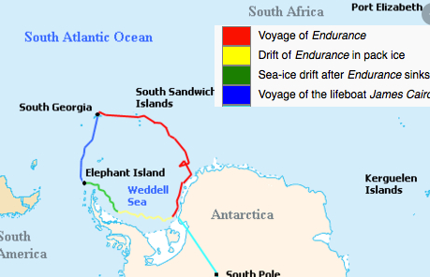
Shackleton and 5 men took one of the lifeboats and sailed to South Georgia to get help for the 22 men left on Elephant Island.
When they reached South Georgia they had to trek across mountains to reach people who could help them.
3 months later, Shackleton returned to rescue his men who had all survived!
This map shows Shackletons amazing journey.

Slide 5
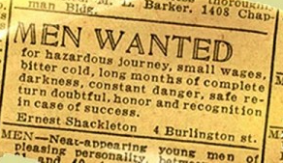
It is said to look like this:
There is a story that Ernest Shackleton put an advertisement in a paper asking for men to join him on his journey, but nobody has ever been able to find it.
It said they would not earn much money.
It was not going to fun or easy.
They might not get back home safely.
It told them of the terrible conditions in the Antarctic
But if they succeeded, reached the South Pole and got home safely they would become famous!
If you read this advertisement would you want to go to Antartica with Shackleton or not? Explain your reasons.

Slide 6
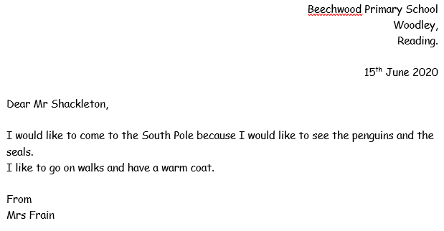
You are going to write a reply to Shackleton’s advertisement telling him if you would or would not like to join him on his journey to the South Pole.
When we write a letter we need to lay it out in a certain way:
Write Dear and then the name of the person we are sending the letter to.
We write our address in the top right hand corner.
Then we write our message in sentences.
We put the date of when we write our letter.
Finally we write from and our own name so they know who has written the letter.

