Slide 1
Thursday 4th June Around the World in 80 days!- Australia
Read the adjectives describing the two kangaroos from yesterday’s story. Use your phonics to sound out each word.
Use one of the adjectives from each kangaroo and write this in a sentence using the ‘er’ suffix to compare him to the other one. For example:
The grey kangaroo is smaller than the brown kangaroo.

Slide 2
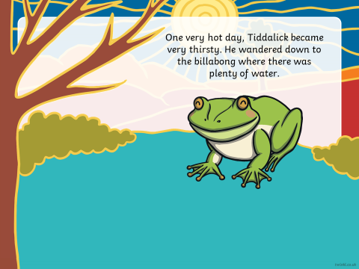
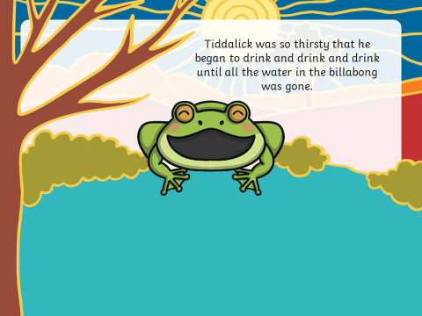
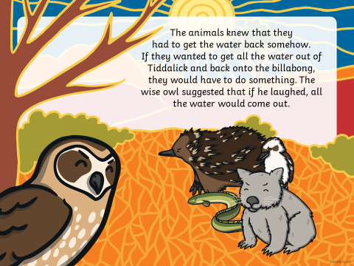
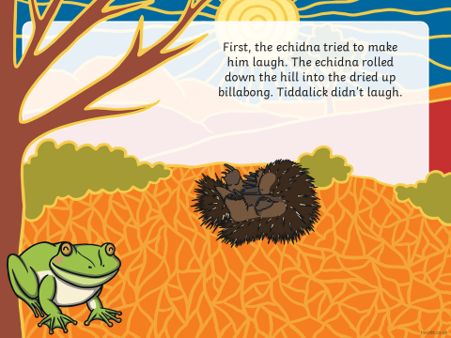
Today’s Aboriginal Dreamtime story is Tiddalick the frog.

Slide 3
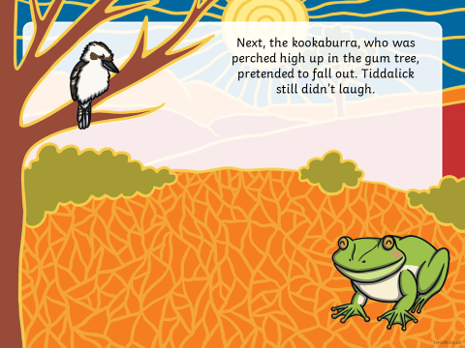
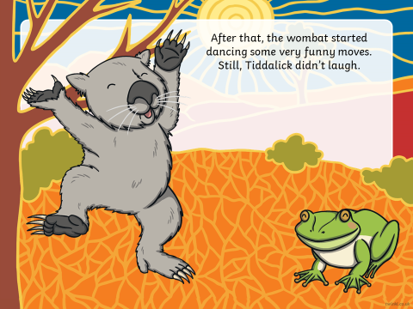
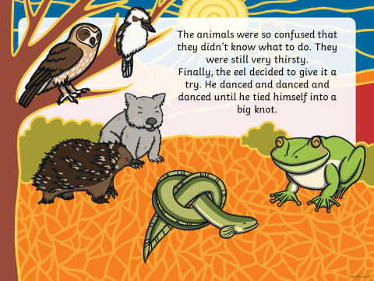
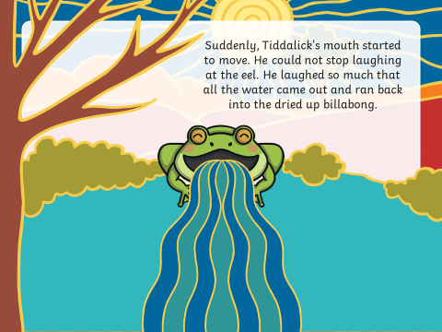
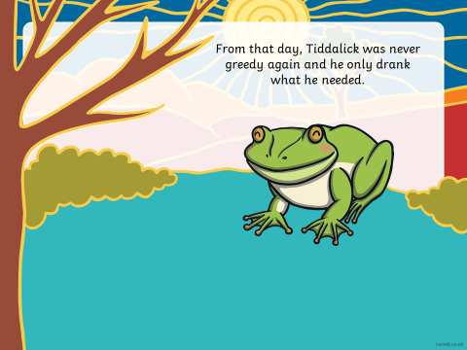

Slide 4
Let’s look at the characters in today’s story.
Remember a character is a person, animal or creature in a story who can think, feel and act (do things). It is the actions of characters that move the story along.
Who was the main character in today’s story?
Can you recall all the other characters in Tiddalick the frog.
What do you think the characters were thinking when they saw all the water had gone from the billabong? How were they feeling?
How did the animals act? What did they do to try to make Tiddalick laugh?

Slide 5
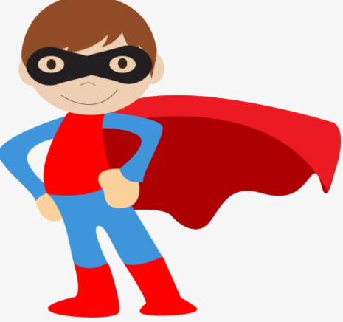
Your writing task today: Remembering the characters in the story, we are going to write a sentence about each of their actions, what they did to make Tiddalick laugh.
Today’s focus is super sentence writing!
Make sure you use a capital letter to start your sentence and a full stop at the end.
Leave clear finger spaces between your words.
Fred talk your words so that you hear and write all the sounds.
Take care with your handwriting, make sure your letters sit on the line and are written neatly.
Make your sentence AMAZING by using adjectives!
The spikey echidna rolled down the steep hill.
Be a super sentence super hero!

