Slide 1
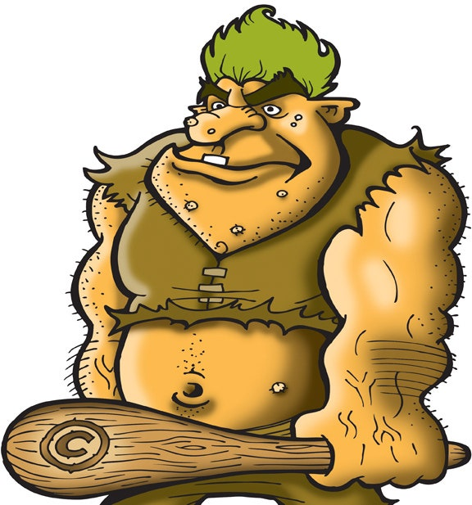
English Wednesday 17th June, 2020
To know the features of a biography

Slide 2
The Features of a Biography
There are a number of features that all biographies should aim to include.
They should tell us the journey of someone’s life, including descriptions of all the main events that happened. We should also learn about the effect of these events.
A successful biography should also aim to use language features that will make it a more interesting and detailed piece to read.

Slide 3
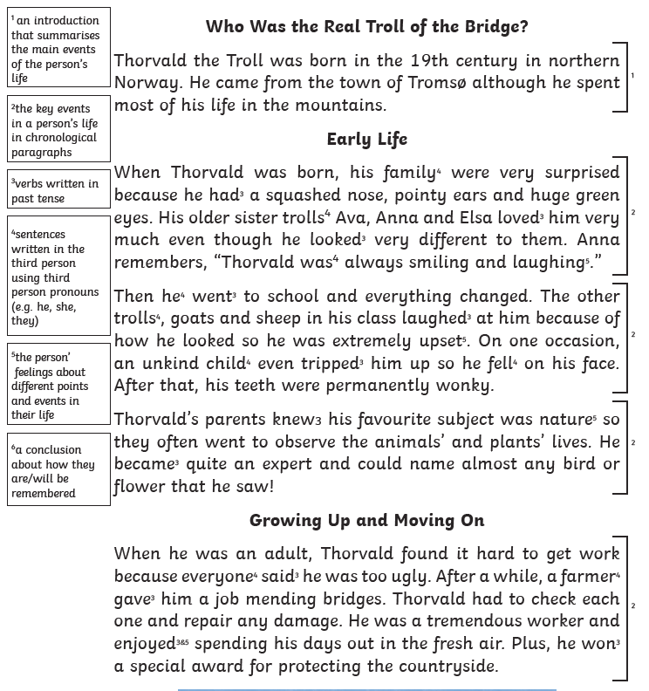
Have a look at the features found in yesterday’s text as you read it through.

Slide 4
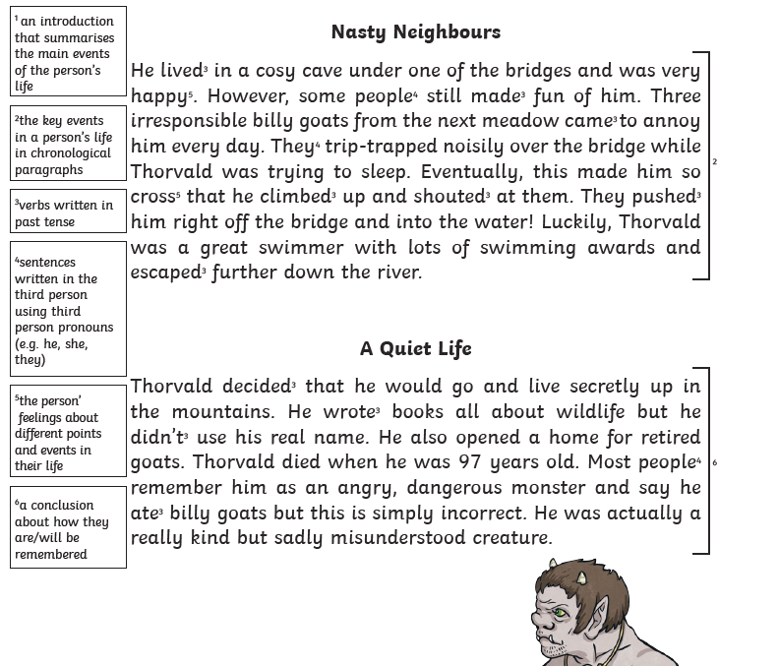
Have a look at the features found in yesterday’s text as you read it through.

Slide 5
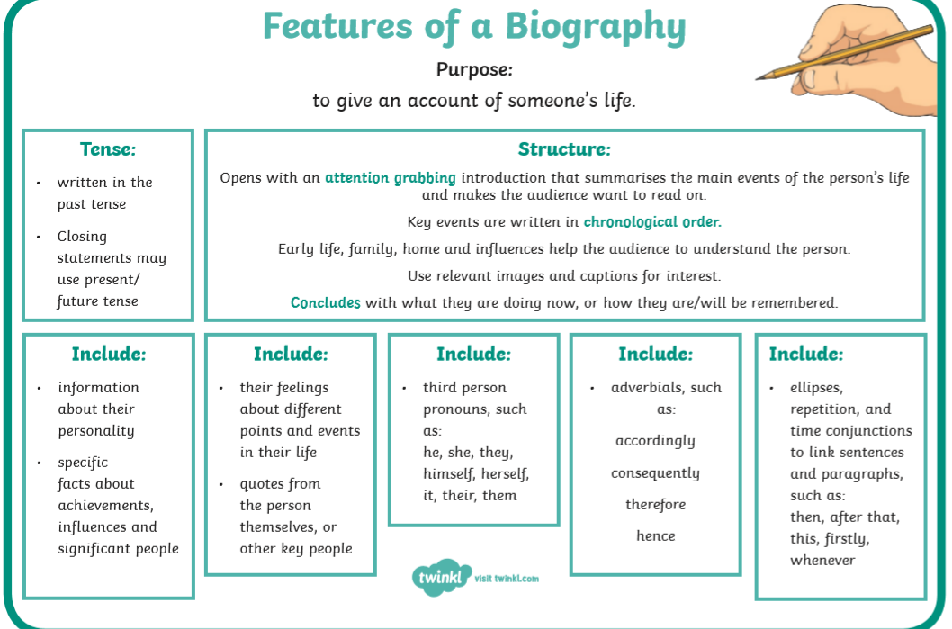

Slide 6
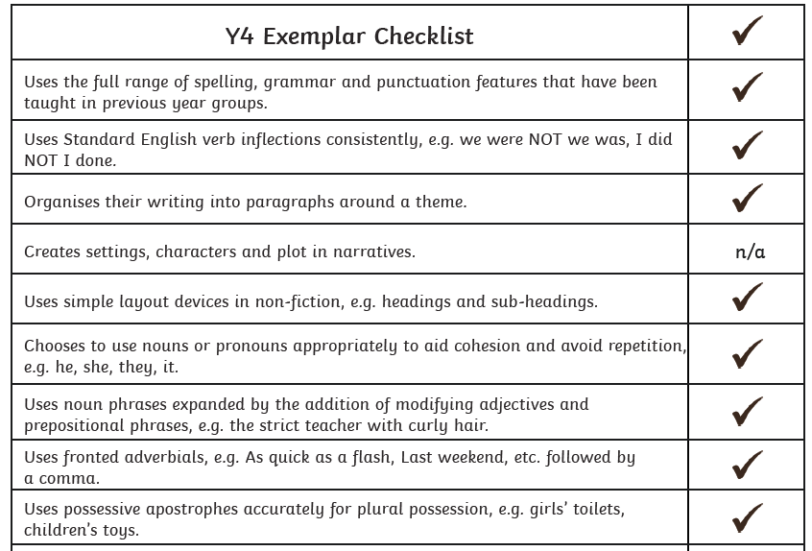
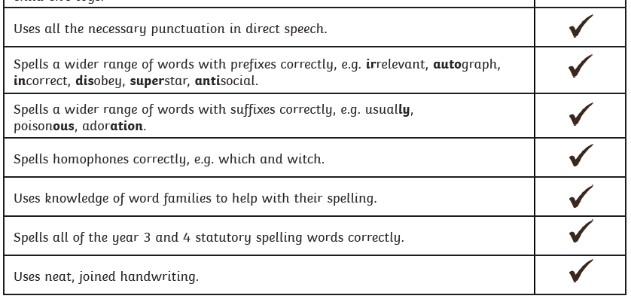
Year Fours should also aim include these language features…

Slide 7
TASK
Using what you’ve learnt about biographies so far, write a short guide to writing a successful biography.
Make sure you include the following:
What should a good biography include about someone’s life?
Can you give any examples?
What other features are there of biographies?
What should the reader know after reading a biography?

