Slide 1
English Tuesday 23rd June, 2020
To write the
‘adult life’ section of a biography

Slide 2
The Adult Life sections
Today we are going to continue our planned biographies. We will use our plans to write the third section.
This section should cover much of your subject’s adult life. If your person got married or had any children this would be part of the biography to include this information. What jobs did they do? What was their personality like at the time? Where were they living? What were their hopes and dreams?
Have a look at the following example…

Slide 3
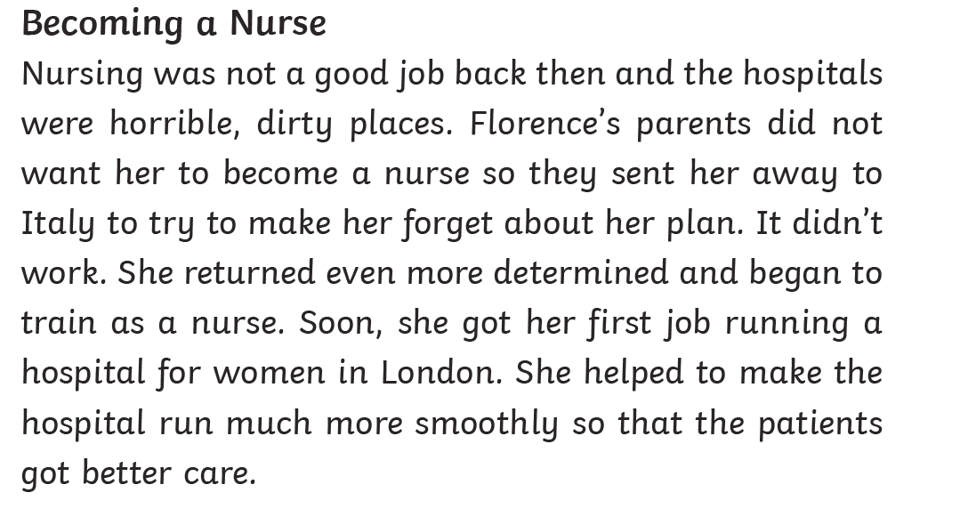
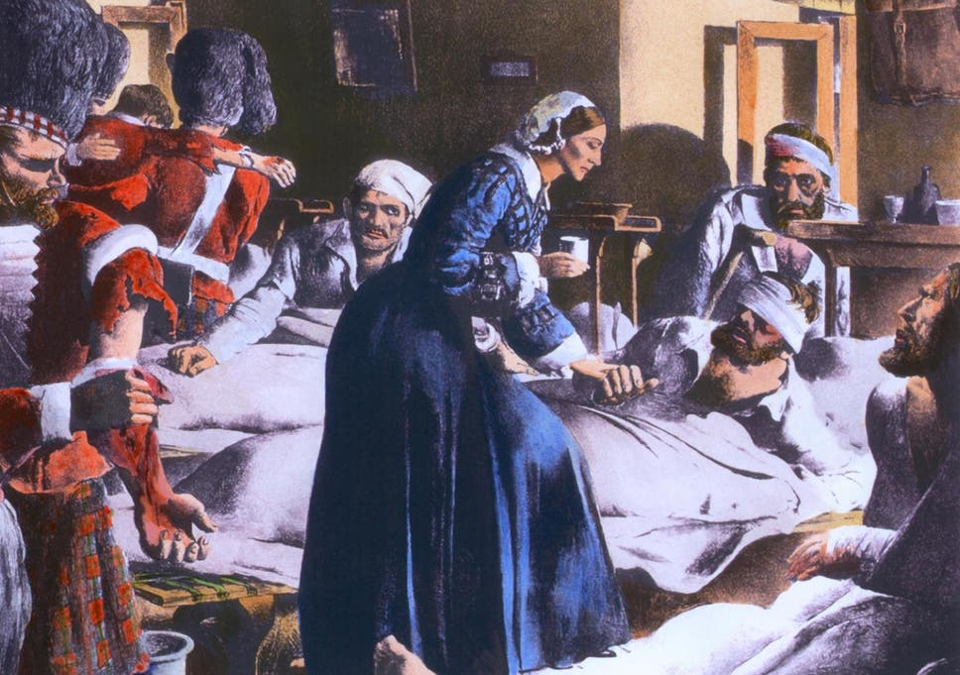

Slide 4
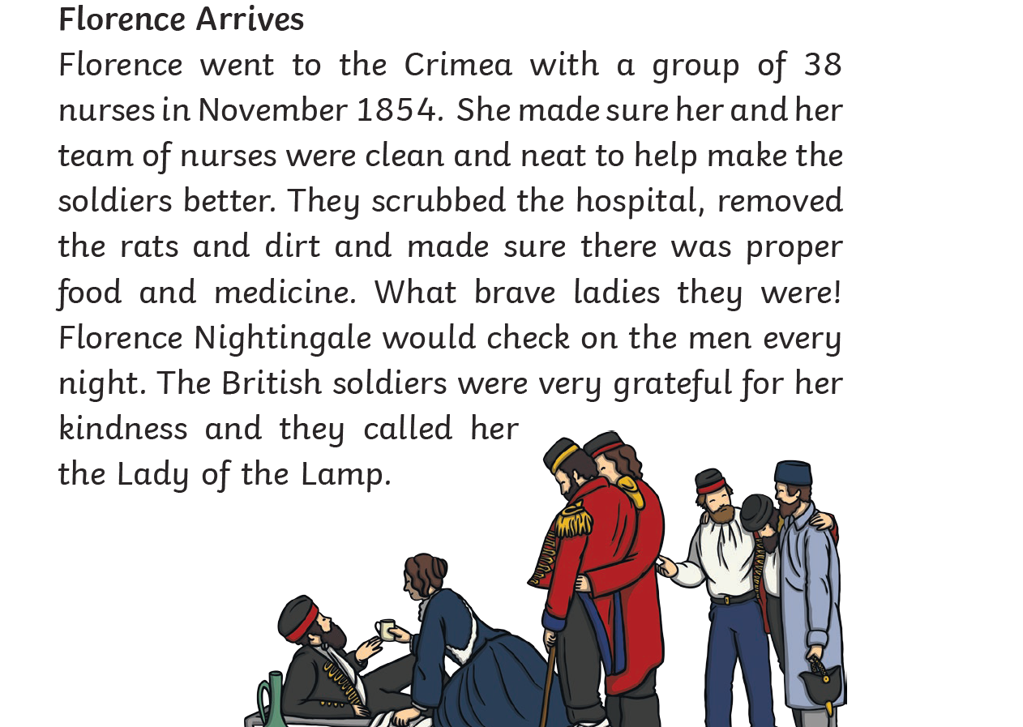

Slide 5
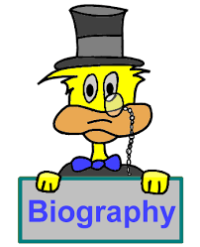
TASK
Section | You could include…
Introduction | What is their name? When and where were they born? What are they best know for?
Early Life | What was their early life like? Who was in their family? Any funny or interesting stories?
Adult Life | What jobs did they do? Did they marry and have any children? Where did they live? What are they like?
Achievements | What are their greatest achievements? How do others think of them?
Conclusion | Are they still alive today? What impact did they have on others?
Write this sections today

Slide 6
Success Criteria for the ‘Adult Life’ section
Criteria | Success?
Use a quote from your subject
Share your person’s feelings about some of these events
Write about the jobs your subject did
Write whether your subject got married or had children
Use an underlined subtitle of Adult Life at the start of the section

