Slide 1
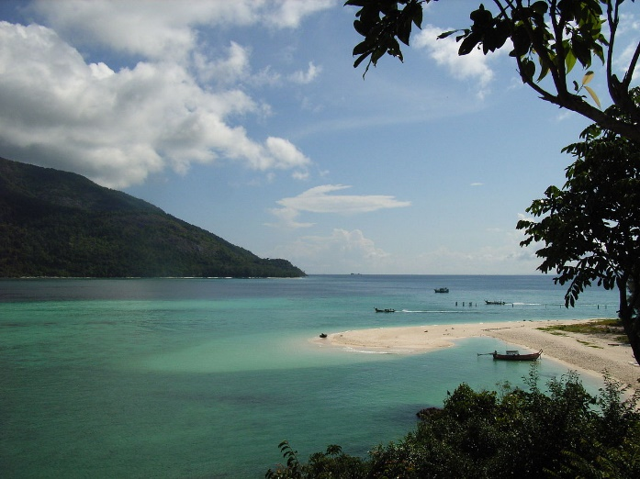
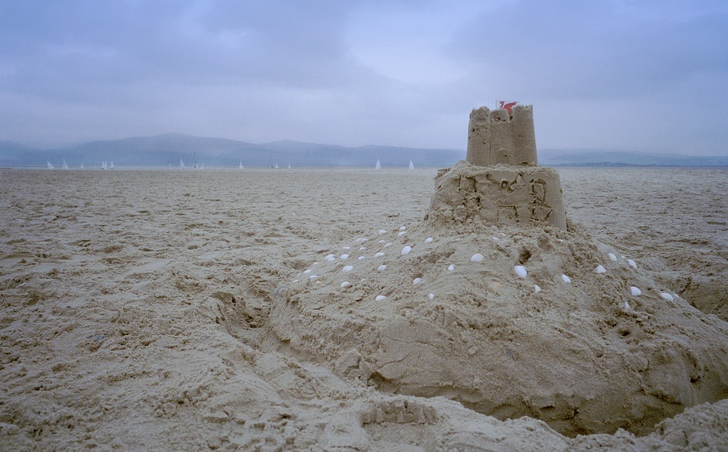
Tuesday 2nd June
Summer

Slide 2
Summer
Read the story, ‘And then Comes Summer.’
https://www.youtube.com/watch?v=O0ZlOkMQGi8
This story references the changes which occur within the season of summer, such as: longer daylight, warmer weather and experiences which tend to happen within this season.

Slide 3
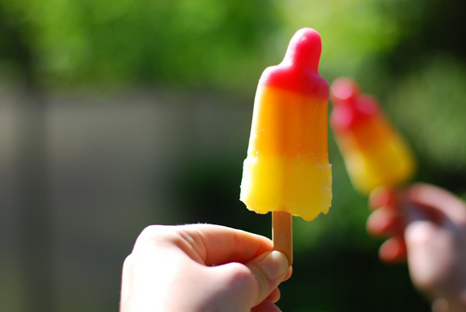
Compare summer to another season.
Summer
Winter
Draw a Venn diagram on a large piece of paper. Your child can draw things which relate to each month. This will help them to make a visual comparison.
Can they find any similarities between the seasons?
Can they label their diagram?
Can they write a sentence saying what they love about summer time?

Slide 4
Note
Please continue with the gross motor activities provided on Monday.

