Slide 1
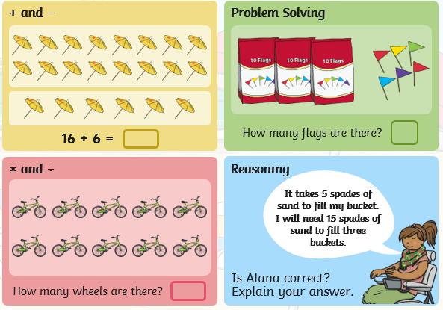
Wednesday 10th June: Position and Direction
Starter:

Slide 2
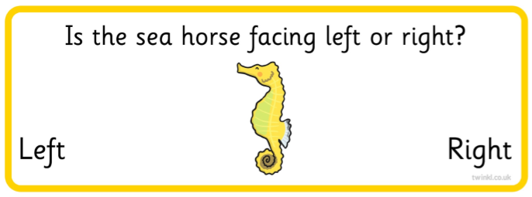
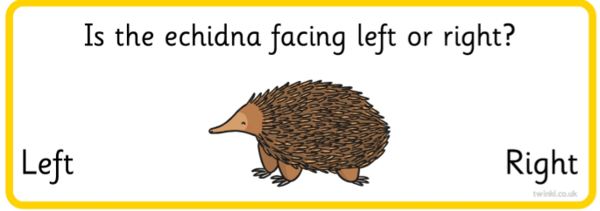
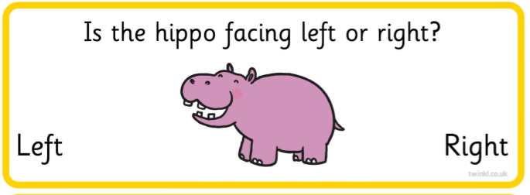
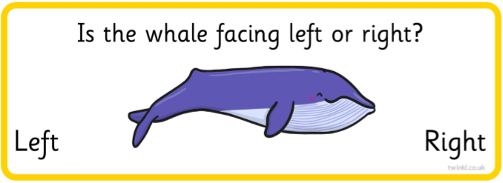
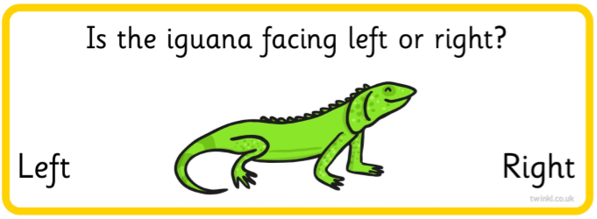
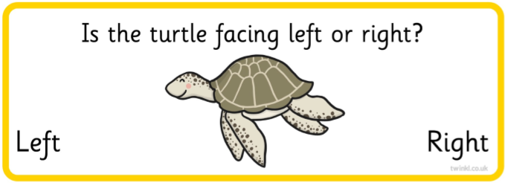
Lets have a quick practice of our left and right.

Slide 3
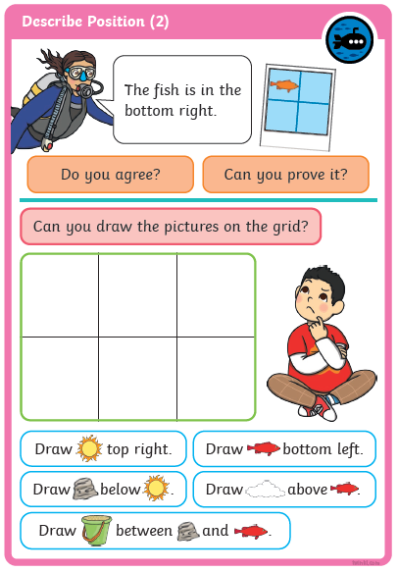
First answer this question.
Then complete the drawing activity by following the directions.

Slide 4
Can you complete some of these position and direction challenges?

Slide 5
Notes:
Purple Grid: Forest
Yellow Grid: Tent

