Slide 1
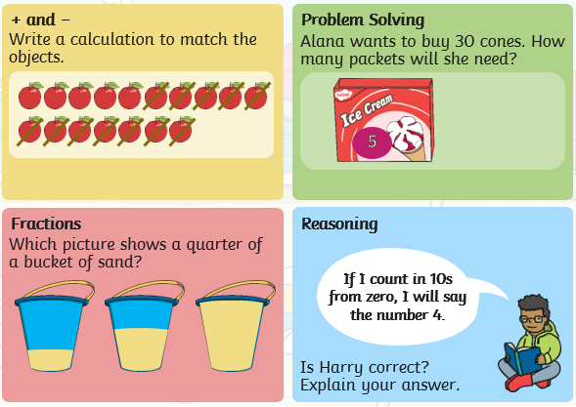
Monday 29th June: Time – Telling the time.
Starter:

Slide 2
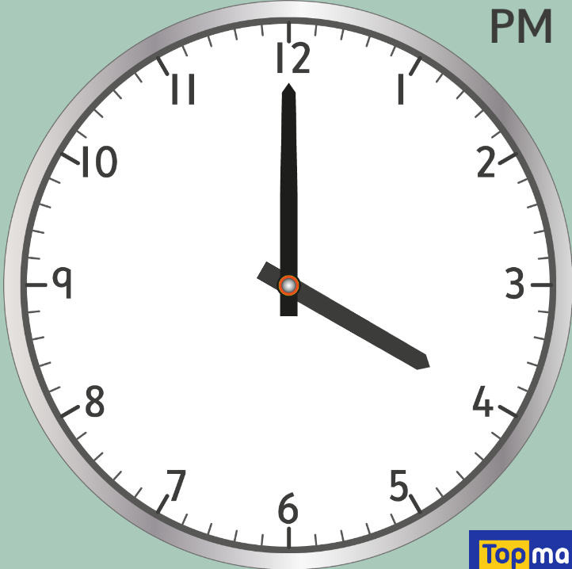
On Friday, we started telling the time to o-clock, we are going to continue this today and complete some challenges.
If you haven’t made your own clock you could use this one.
https://www.topmarks.co.uk/time/teaching-clock
What is the time on this clock?

Slide 3
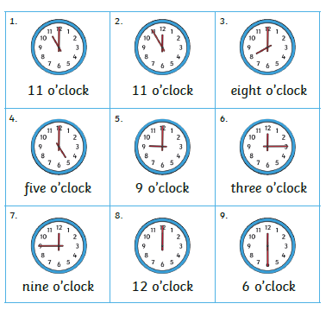
Here are 9 clocks showing different times.
Are they all correct?
Which ones are wrong, can you explain why?
Answers are on slide 5.

Slide 4
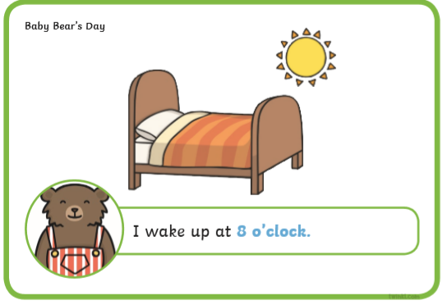
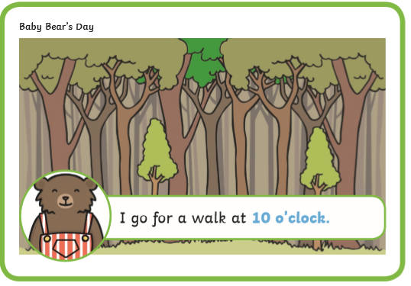
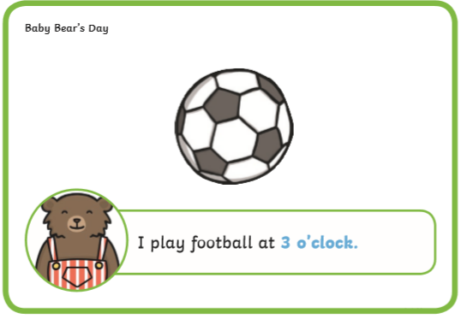
Baby Bear is explaining his day and the different times he does things.
Can you draw clocks and pictures to show what time he is doing each item.
Can you make up your own examples of things he can do during the day.

Slide 5
Tomorrow we will be learning to tell the time to half-past.
Answers:
2, 6, 7 and 9 are wrong.
They are wrong because they have the minute and the hour hand in the wrong place.
The hour hand must point to the 12 when the time is o-clock.

