Slide 1
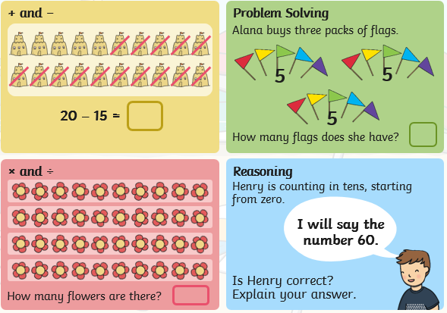
Thursday 4th June: Position and Direction
Starter:

Slide 2
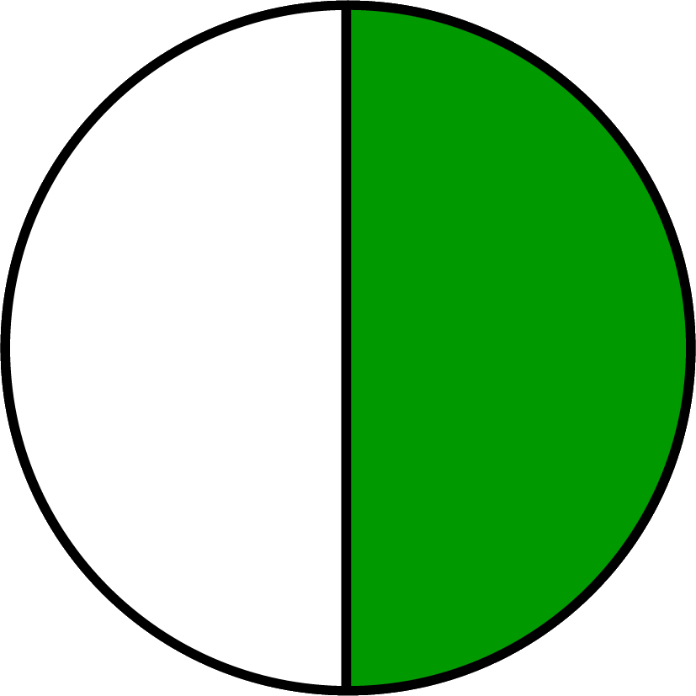
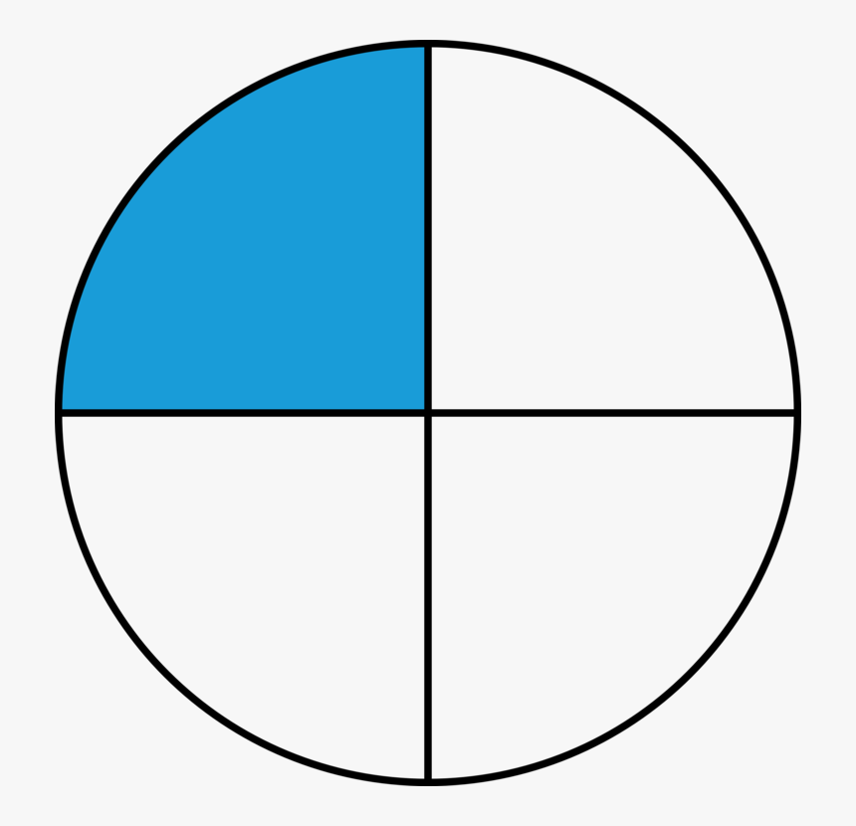
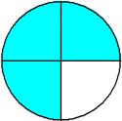
Today we are going to be learning about turns.
We are going to be learning how to make a half turn and a quarter turn.
Do you remember hearing about the words half and quarter?
This shows 3 quarters because there are 3 parts coloured in.
This shows ‘half’ of a circle. Remember when we find half we split into 2.
This shows ‘quarter’ of a circle. When we find a quarter we split it into 4.

Slide 3
Practice standing up and turning around.
Can you turn half way?
Can you make a quarter turn?
Can you make a 3 quarter turn?
Follow along with this supermovers dance, it will help you understand half and quarter turns.
https://www.bbc.co.uk/teach/supermovers/ks1-maths-position-&-direction/zhh9scw

Slide 4
Challenge
Use all of the information we have learnt so far to help you give and follow instructions.
Take it in turns to give someone in your family directions. Then they can give you directions to follow.
Remember you could go forwards, backwards, left, right.
Can you make quarter and half turns?
If you still need to practice your left and right, there is an activity assigned on Mathletics.

