Slide 1
Thursday 4th June Perimeter and area LO To apply my knowledge of perimeter and area
Steps to success
I solve problems involving perimeter and area.
I can calculate perimeter and area.
I can know the difference between perimeter and area.
Work through the slides. Try to follow the examples.
Time yourself on the tables test.
Do the worksheets Mild, Hot and Spicy.

Slide 2
Finding solutions with a missing side.
Can we solve the missing side problem for area?
15cm
The area is 60cm². What will the missing side be?
Area is length x breadth, so 1 side will be Area divided by length or breadth. Here we will have 60 ÷ 15.
If we have a big divisor, we can subtract.
60 -15 = 45 – 15= 30 – 15 = 15 – 15= 0
We have subtracted 15 four times, so the answer is 4.
Solve problems when the shape has a missing side.
15cm
We use the properties of a rectangle to find the length of a missing side.
The perimeter is 40cm. We know that the 2 lengths will be 30cm. (15cm + 15cm)
We have 10cm left for the 2 breadths. So each one will be 5cm.
The missing side will be 5 cm.

Slide 3
Real life problems
The brown rectangle represents a room. 8m by 7m.
What is the area? 56m²
The blue square shows the front door and entrance hall. This is 2m².
The family wants to buy a new carpet. They will not put carpet in the entrance hall. How many square metres do they need? 54m²
The farmer wants to fence his field. The field is 80m by 25m. He will leave out 3m for the gates.
How many metres does he need?
80m
25m
You will have to work out the perimeter and then subtract the part where the gates go.
2 x ( 80 + 25) = 210
Then subtract 3 = 210 – 3 = 207m

Slide 4
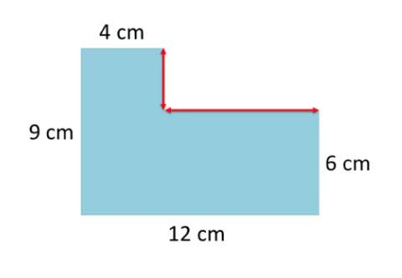
Area of an irregular shape
Find the area of this shape.
The easiest way is to divide it into 2 shapes. Work out the length of the sides and calculate the area of each shape.
Draw a line to separate the top rectangle. (click)
The yellow rectangle shows this area. (Click)
Calculate the length of the sides. The opposite side is 4cm. What is the length of the other sides?
We know it must be 3cm because the right hand side is 9 cm. On the left side, the line is only 6cm. We will need to make it up to 9cm.
Therefore, the yellow rectangle is
4 x 3 = 12 cm²
Try to calculate the lower rectangle. Then click for the answer. 12 x 6 = 72cm²
Altogether the area of the shape will be 12cm² + 72cm²= 84cm²
8cm
3cm

Slide 5
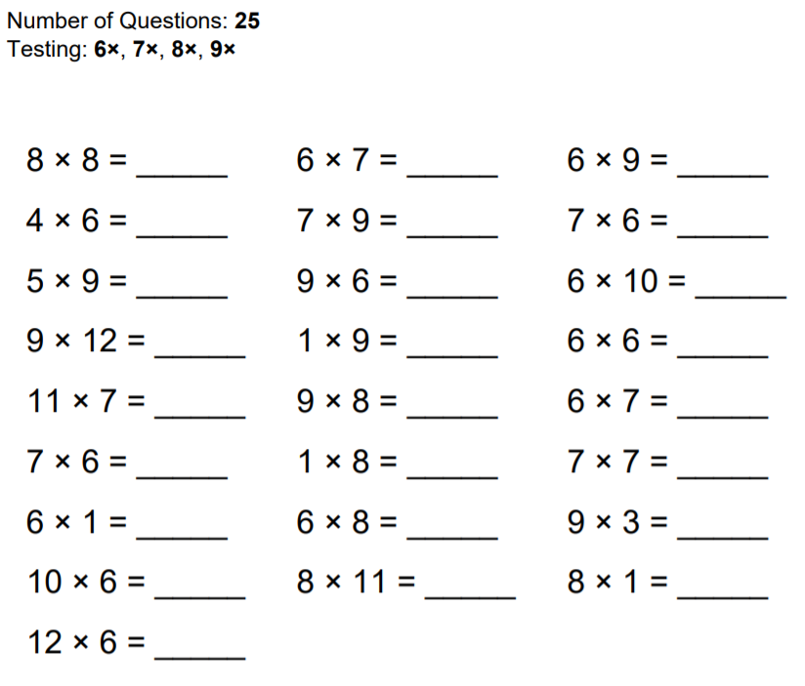
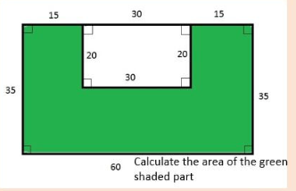
Check your times tables . Try to complete the sheet under 1 minute .
Challenge:
Use a calculator if necessary.

