Slide 1
Wednesday 24th June 2020 LO: To select the appropriate type of graph
Steps to success
I can plot data accurately.
I can select the correct type of graph for the data that I have.
I know why we use different types of graphs.
Go through the slides. There are quite a few animations showing the processes so this will not print off very well. Do the tasks on the slides and click for the answers.
Work through the sheets – Mild, Hot and Spicy.
Keep practising your times tables.

Slide 2
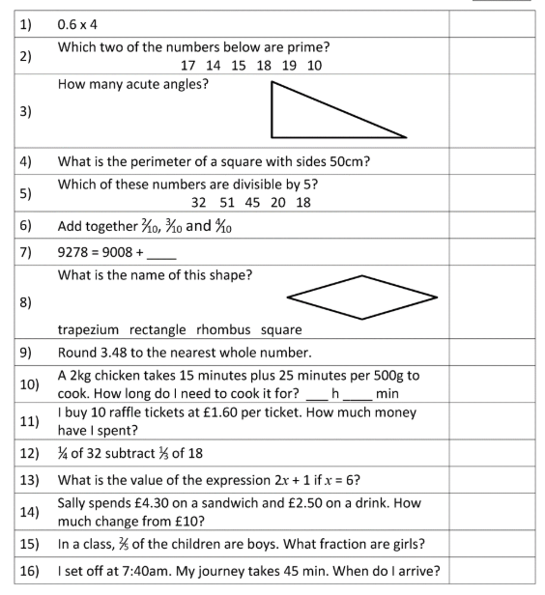
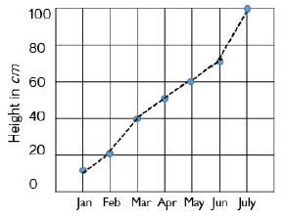
Using graphs
Starter: We haven’t had some brain gym for a while. We have never done work like no. 13. See if you can work it out.
Graphs are useful as a visual representation of data.
They sum up information which can be easily interpreted.
The type of graph used depends on what you want to show.
For example – Distance and time are best shown on a line graph. This shows height growth over a period of time
Remember that a prime number has only 2 factors 1 and itself.
Plant growth

Slide 3
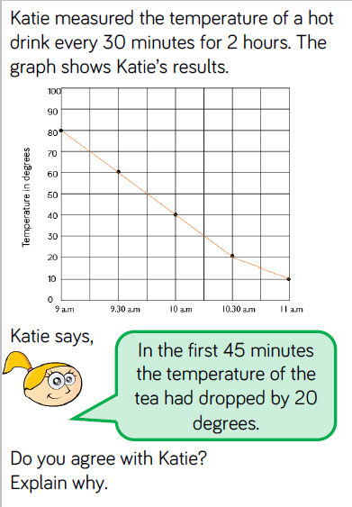
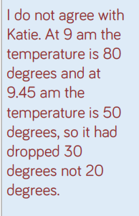
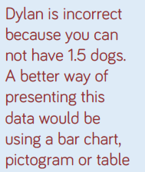
Look at these examples. Solve the problems.

Slide 4
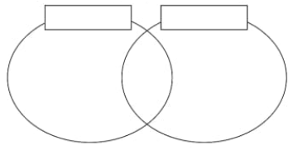
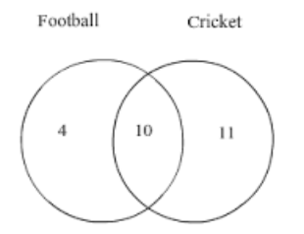
Using a Venn diagram
Sometimes we need another way to represent the data.
If we have an example of 25 children liking sport – football or cricket. It is possible that some children like football AND cricket.
Venn diagrams allow us to see when categories overlap.
Try to build this diagram for multiples of 2 and 3. ( up to 36)
Multiples of 2
Multiples of 3
But 10 like football and cricket. They belong in both circles
4 8 10 14 16 20 22 26 28 32 34
6
12 18
24 30
36
3, 9, 15, 21, 27, 33
4 like football only
11 like cricket only
Altogether 14 children like football.
Altogether 21 children like cricket.

Slide 5
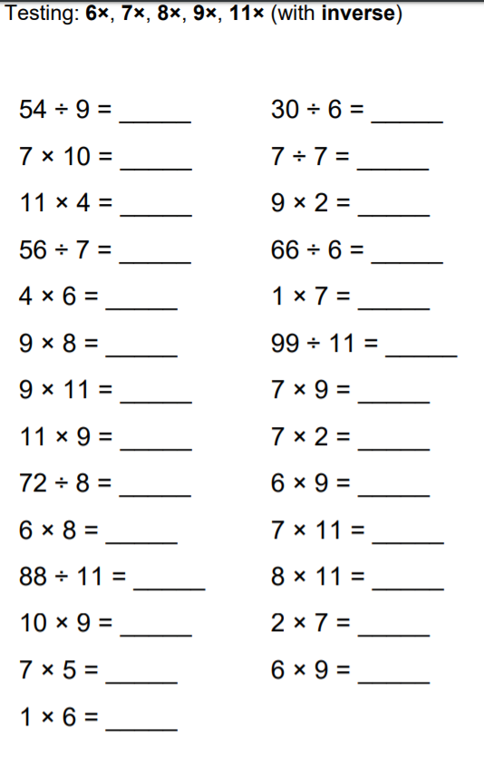
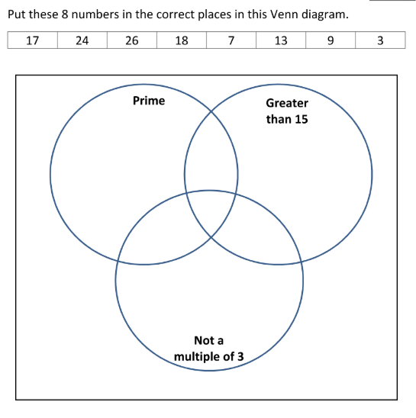
More complicated diagrams. Beware this is a challenge!
Times tables! How fast are you now?
3
24
All these numbers are not multiples of 3
18
17
7
13
26
17 is greater than 15. Not a multiple of 3. It is a prime number.
9 is not a prime number or greater than 15 and it is a multiple of 3. It does not fit in.

