Slide 1
22.6.20 Bonds to 100
Today you are going to use your number bond to 10 knowledge to help you work out sums to 100.
Recap your number bonds here- https://www.topmarks.co.uk/maths-games/hit-the-button
It might be helpful to use a hundred square for some of the questions.
You can also practise your number bonds to 100 here https://www.topmarks.co.uk/maths-games/hit-the-button

Slide 2
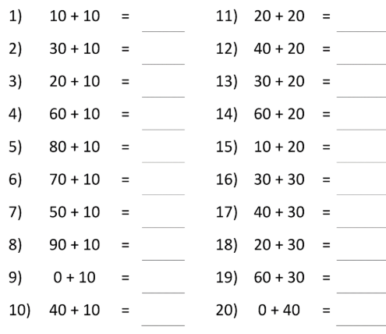
22.6.20 Bonds to 100
Mild

Slide 3
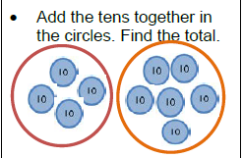
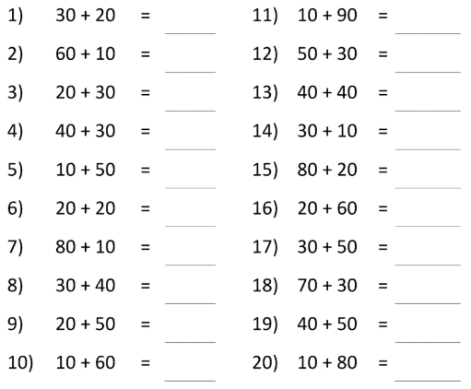
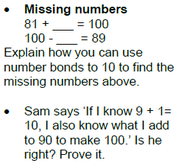
22.6.20 Bonds to 100
Hot

Slide 4
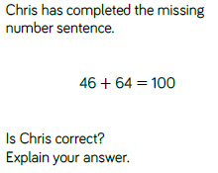
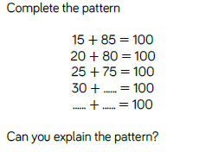
22.6.20 Bonds to 100
Spicy
Notes:
Answers
Chris
Chris is incorrect. He has seen number bonds to 10 but forgotten that he would need to exchange ten ones for one ten.
Complete the pattern 2
30 + 70 = 100
35 + 65 = 100
The first numbers are going up in fives and the second numbers are going down in fives. All of the number sentences are number bonds to 100

Slide 5
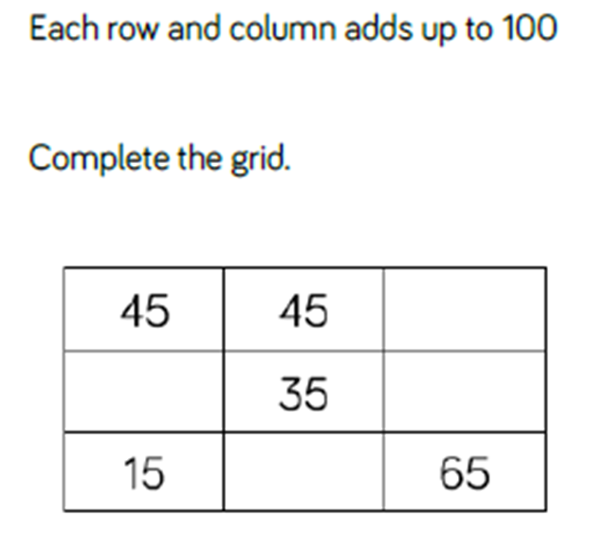
22.6.20 Bonds to 100
Challenge!

