Slide 1
Wednesday 1st July
This week we will continue with the 3 challenges:
Phonics
Common Exception Words
Reading and Comprehension.
Remember you could also do the hold a sentence lesson on youtube: https://www.youtube.com/channel/UCo7fbLgY2oA_cFCIg9GdxtQ
Have a go at each activity and the answers will always be on the last slide.

Slide 2
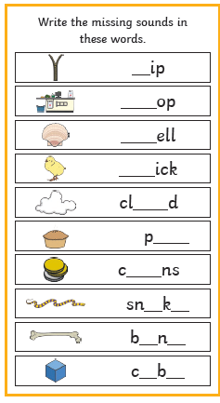
Phonics
Can you fill in the missing sounds for these words.
Challenge: Choose a word to write in a sentence.

Slide 3
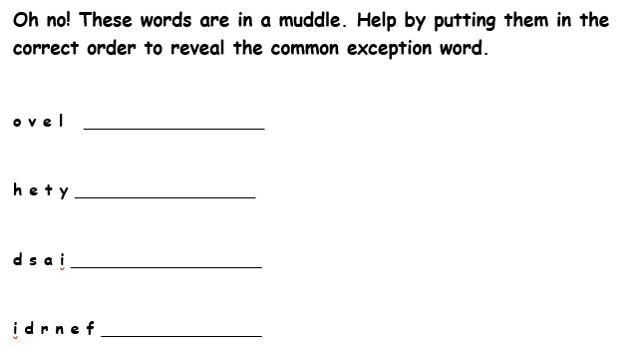
Common Exception Words
Can you re-arrange the letters to make some common exception words.

Slide 4
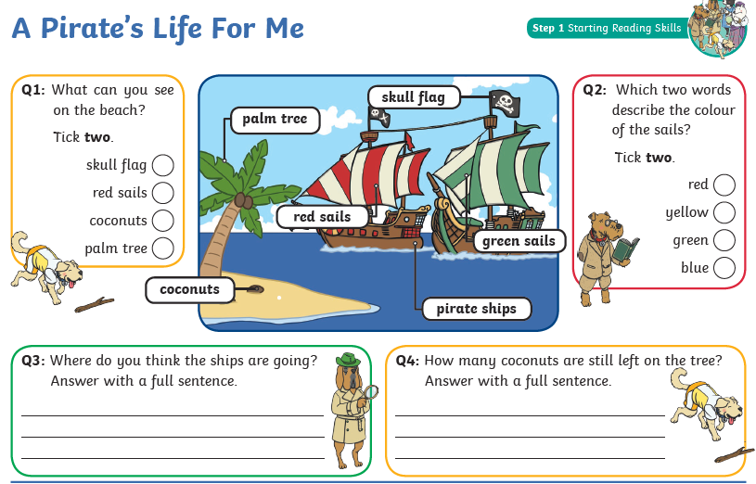
Look at the picture and read the labels. Then answer the questions.

Slide 5
z
love
sh
they
sh
said
ch
friend
ou
ie
oi
A Pirate’s Life
Coconuts and a Palm Tree
Red and Green.
Question 3 is your own answer, did you answer in a full sentence?
4. There are 2 coconuts left on the tree.
a
e
o
e
u
e

