Slide 1
Friday 12th June LO to reflect on the text
The following questions are meant to get you thinking about what you have read.

Slide 2
Are the following statements true or false? Give a good reason for your opinion.
The pelican was the manager of the Ladderless Window Cleaning Company.
The animals were well-educated.
The window-cleaning business was successful.
The Duke of Hampshire was a kind man.
Billy was very health conscious and did not approve of sweets.
The writer made the animals talk and have jobs like ordinary people, but he made them eat normal food.

Slide 3
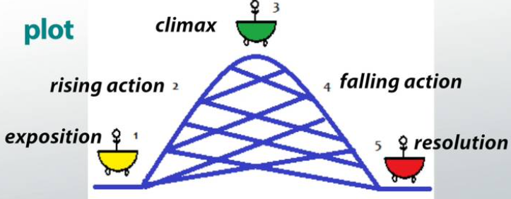
The plot
The plot is the series of events that make up a story.
Plots have five main parts that always take place in the same order: beginning (where exposition, or setting and characters are introduced), rising action, climax (the most exciting part), falling action, and resolution. We often talk about this in your story writing.

Slide 4
Think about the plot in The Giraffe and the Pelly and Me.
Who are the main characters?
Who is the story really about? Billy or the 3 animals?
Were you surprised when Billy asked the Duke for a sweetshop? Was there a sign earlier in the book?
Do you think he could have managed to get a sweetshop without the help of the Ladderless Window Cleaning Company?
How else could a little boy become the owner of a sweet store? If you were the writer, what method would you have created?
(You do not need to write a whole story. Write 5 or 6 lines describing your main idea.)

