Slide 1
Reading Tuesday 15th June, 2020
To find information about someone from a biography

Slide 7
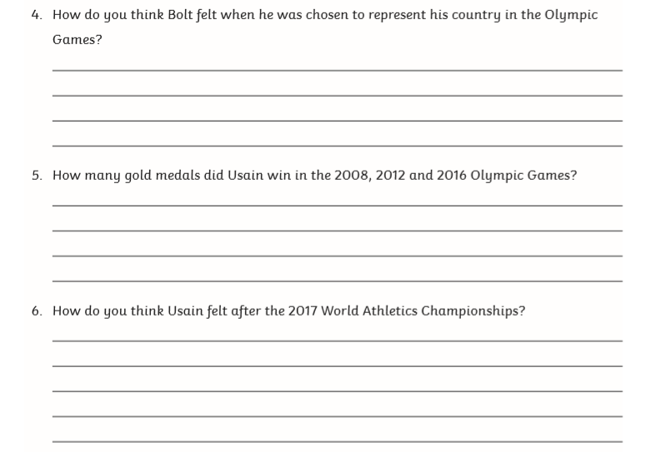

Slide 8
