Slide 1
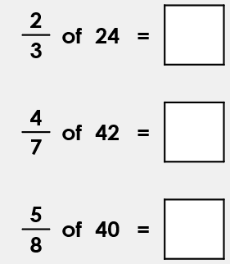
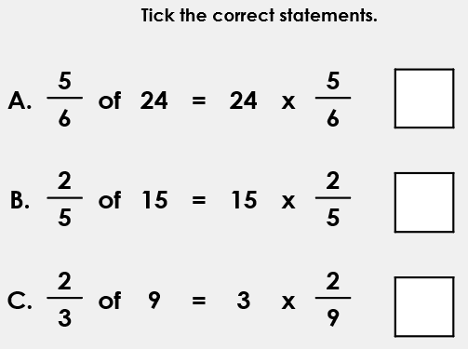
L.O: To Use Fractions as Operators 25.06.2020/ XXV.VI.MMXX
If needed, draw visuals in your books to help you.

Slide 2
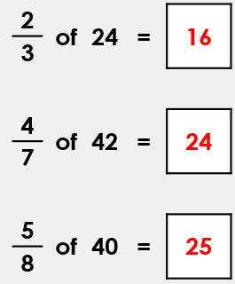
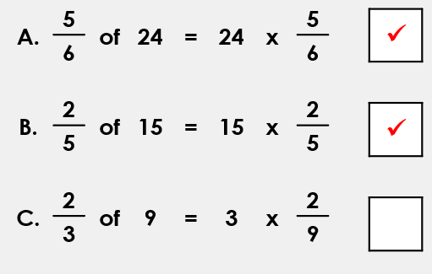
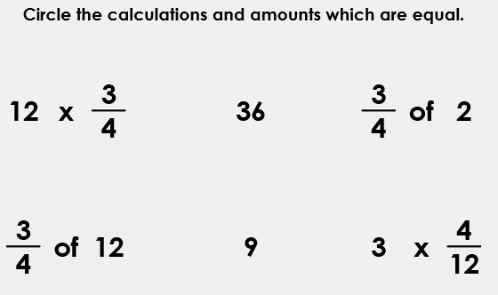

Slide 3
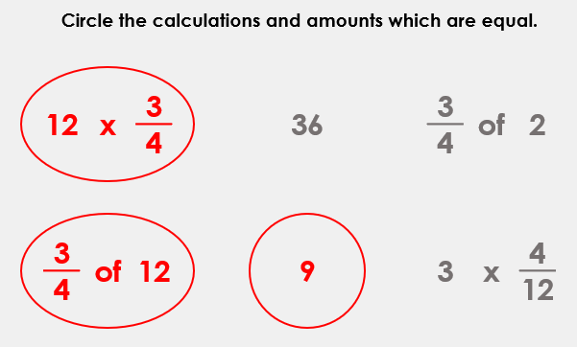
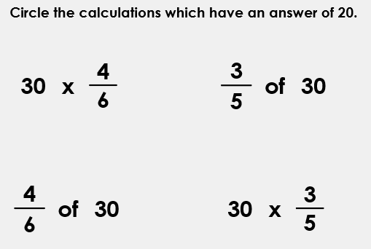

Slide 4
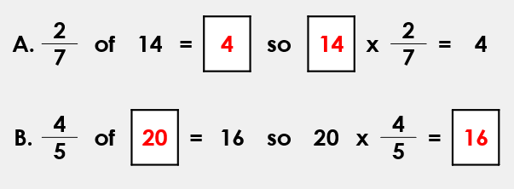
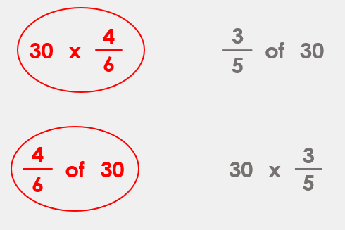
Daily Maths Challenge:
Task:
Review the fraction concepts that you’ve learned in the past couple of weeks. We are going on a Fractions Adventure tomorrow!

