Slide 1
Measure Capacity
LO: to read the volume in each container.
Steps to success
I can say how much liquid is each container.
I can identify what the unit of measurement the liquid is being measured in.
I can measure liquid correctly.

Slide 2
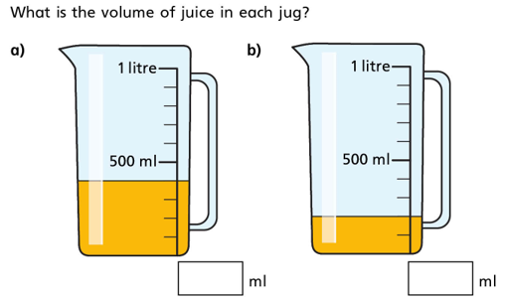

Slide 3
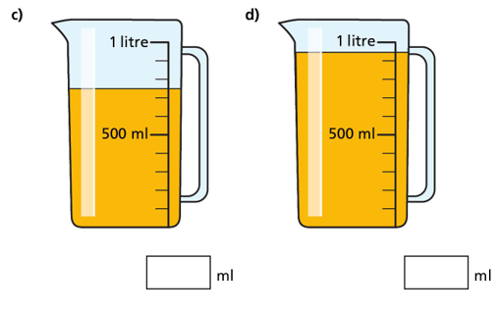

Slide 4
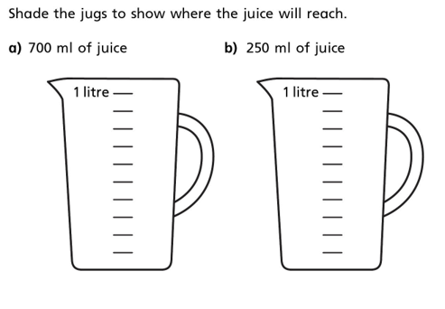

Slide 5
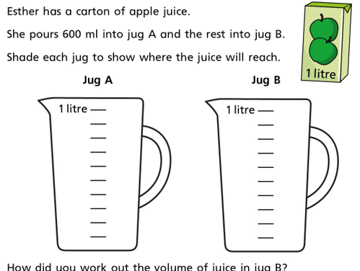
Activity
Make some juice for all the adults but make sure they all get the same amount.

