Slide 1
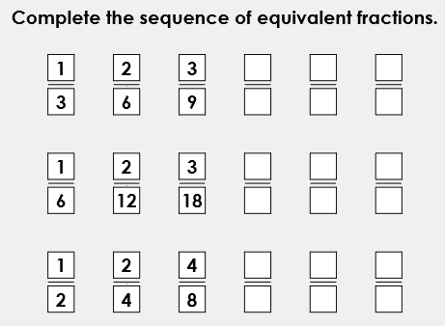
L.O: To add multiple fractions- 16.06.2020/XVI.VI.MMXX Starter:
When making equivalent fractions, whatever you multiply the denominator by you have to multiply the numerator by.
Example: In the first row 3 is multiplied by 2 to get 6, therefore 1 also needs to be multiplied by 2 to get 2.

Slide 2
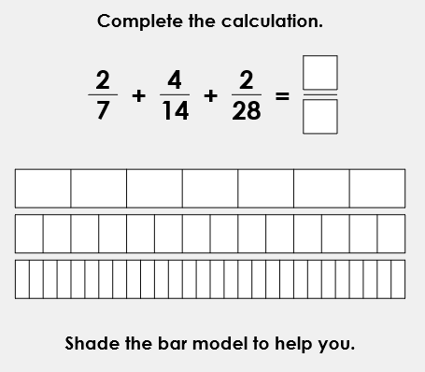
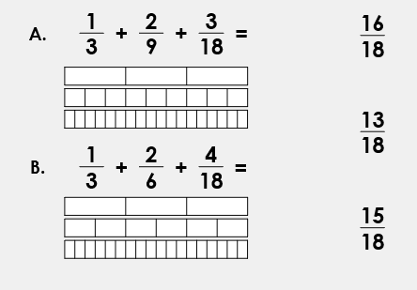
Change the fractions so they all have a common denominator. Remember, whatever you do to the bottom you must do to the top

Slide 3
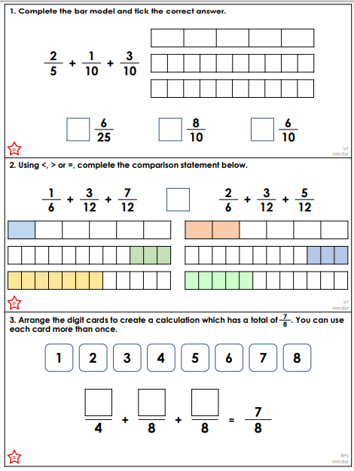
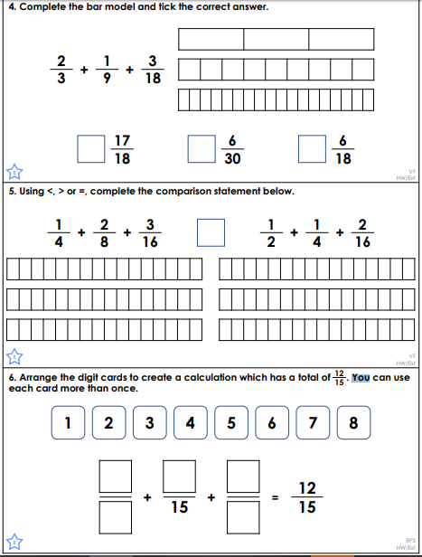
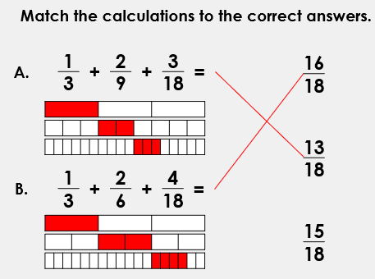
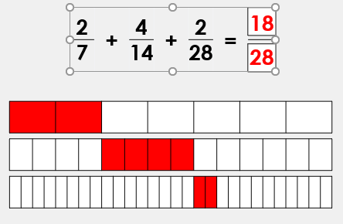
Mild and Hot Worksheets

Slide 4
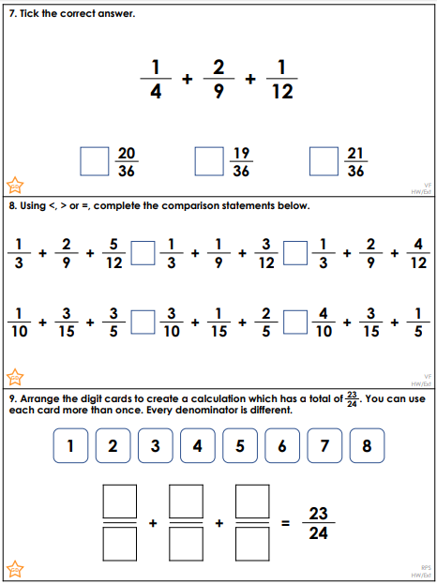
Spicy Worksheet and Daily Maths Challenge

Slide 5
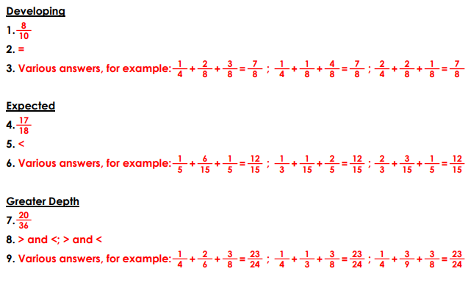
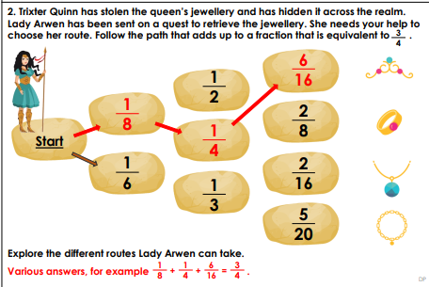
Answers

